Slide 1
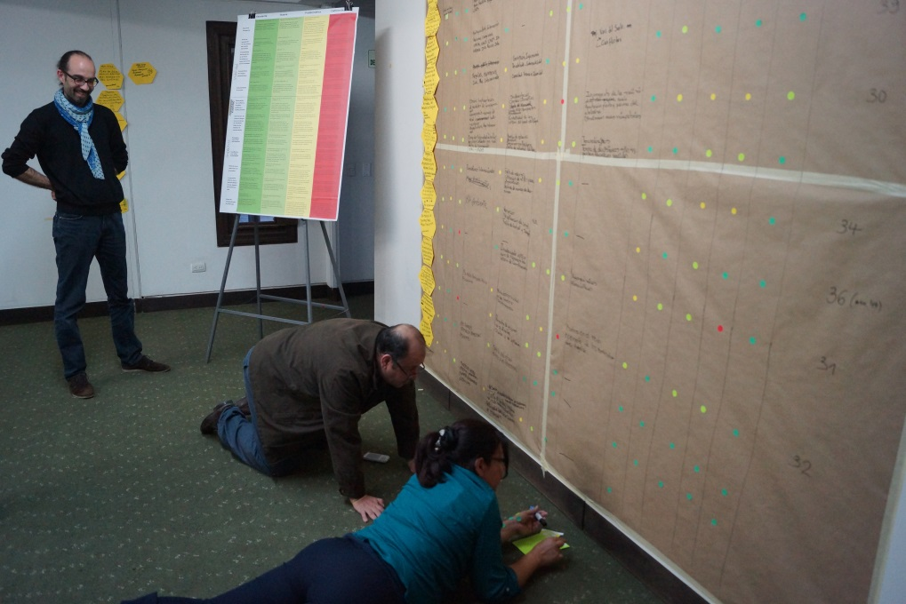
Assessment and prioritization of existing strategies
Phase III
Comprehensive evaluation, prioritization and strategy formulation
Step 18
© Pierre Ibisch 2014

Slide 2
Credits and conditions of use
© Centre for Econics and Ecosystem Management, 2014
The Centre for Econics and Ecosystem Management strongly recommends that this presentation is given by experts familiar with the adaptive management process in general (especially as designed as the Conservation Measures Partnership’s Open Standards for the Practice of Conservation) as well as the MARISCO Method itself.
You are free to share this presentation and adapt it for your use under the following conditions:
You must attribute the work in the manner specified by the authors (but
not in any way that suggests that they endorse you or your use of the work).
You may not use this work for commercial purposes.
If you alter, transform, or build upon this work, you must remove the Centre for
Econics and Ecosystem Management logo, and you may distribute the resulting work
only under the same or similar conditions to this one.
This material was created under the leadership and responsibility of Prof. Dr. Pierre Ibisch and Dr. Peter Hobson, co-directors of the Centre for Econics and Ecosystem Management, which was jointly established by Eberswalde University for Sustainable Development and Writtle College. Compare: Ibisch, P.L. & P.R. Hobson (eds.) (2014): The MARISCO method: Adaptive MAnagement of vulnerability and RISk at COnservation sites. A guidebook for risk-robust, adaptive, and ecosystem-based conservation of biodiversity. Centre for Econics and Ecosystem Management, Eberswalde (ISBN 978-3-00-043244-6). 195 pp. - The Powerpoint Presentation was conceived by Jamie Call, Christina Lehmann and Pierre Ibisch. Authors of graphs and photographs are indicated on the corresponding slides. Supported by the Deutsche Gesellschaft für Internationale Zusammenarbeit (GIZ) GmbH on behalf of the Bundesministerium für wirtschaftliche Zusammenarbeit und Entwicklung (BMZ).

Slide 3
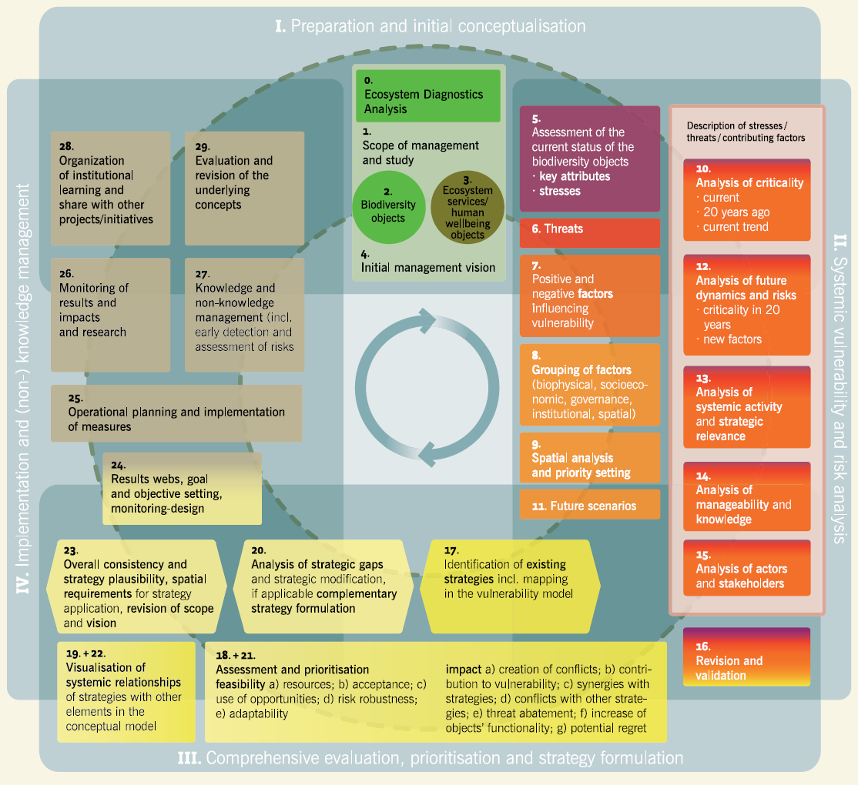

Slide 4
Learning objectives
Participants have a clear understanding and are able to explain the use of this step as it offers an assessment of the strategies due to feasibility and potential impact, allowing adjustments of strategies and prioritisation in order to improve effectiveness and robustness
Furthermore the evaluation helps to avoid negative effects by the implemented strategies which remain unforeseen without proper reflection
Participants have the knowledge and ability to guide the assessment and prioritisation of the collected existing strategies due to the criteria and categories for feasibility and potential impact and collect the results in an appropriate format (e.g. table)
For Step 21: Participants have a clear understanding and are able to explain that this step is important to anticipate as best as possible the potential effectiveness and feasibility of the new complementary strategies.

Slide 5
Outline
What is the assessment and prioritization of existing strategies?
Why do we assess and prioritize existing strategies?
How do we assess and prioritize existing strategies?
1) The process of assessing and prioritising existing strategies
2) The evaluation of feasibility of existing strategies
3) The evaluation of impact of existing strategies
Practical Tips

Slide 6
What is the assessment and prioritisation of existing strategies?
Detailed critical evaluation of existing strategies that may have been implemented already, or not
Conducted through a peer-review process
Carried out either with the planning team, external reviewers or a combination of both

Slide 7
Why are existing strategies assessed and prioritised?
Often strategies are carried out without any follow-up assessment of their feasibility or potential impacts
Helps to adjust the strategy design
Portfolio of existing strategies from Step 17 can be prioritized to improve their effectiveness and robustness
It also promotes reflection, which can decrease or avert the negative effects caused by implementation of a strategy
Merit in self-reflection by analyzing strategies the team established already
→ However, external teams can offer a more balanced and objective perspective
→ may be better able to identify risks and mistakes associated with the strategies

Slide 8
How are existing strategies assessed and prioritised?
Existing strategies are classified by two criteria:
Feasibility
Degree to which a strategy is likely to be implemented under prevailing conditions in the management area
It is related to available resources but also to risks, restrictions and conflicts
Impact
Effects and changes both within and outside the designated management area that can be attributed to the strategic action, and that directly or indirectly generate consequences for the conservation objects

Slide 9
How are existing strategies assessed and prioritised?
These criteria are further subdivided:
Feasibility
Necessary resources
Level of acceptance from relevant stakeholders
Probability of benefitting from external factors
Probability of harmful risks
Adaptability to change

Slide 10
How are existing strategies assessed and prioritised?
Impact
Causation of social, political e institutional conflicts
Causation of new risks that increase the vulnerability of conservation objects
Synergies with other strategies
Conflicts with other strategies
Threat abatement effectiveness
Direct increases in biodiversity functionality
Level of potential regret

Slide 11
How are existing strategies assessed and prioritised?
1) The process of assessing and prioritising existing strategies

Slide 12
How are existing strategies assessed and prioritised?
1.
Line the wall approximately 3m high x 3 m wide with brown packing paper taped around the edges

Slide 13
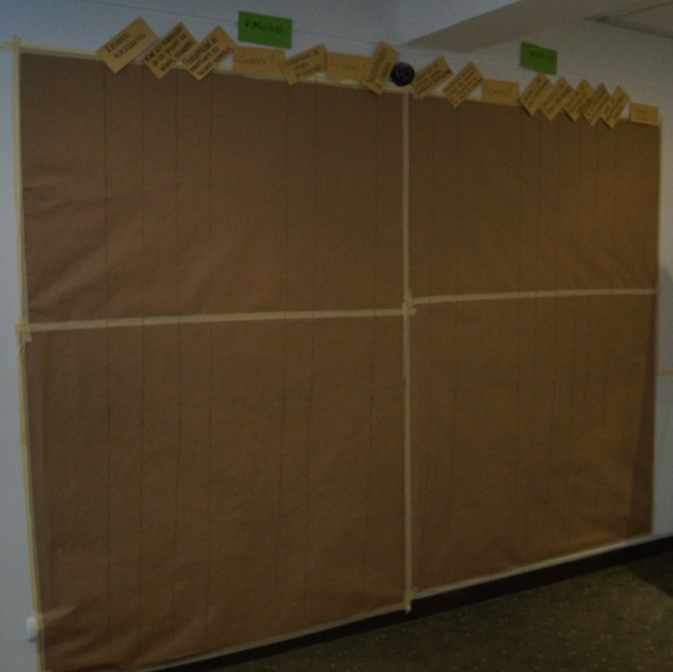
How are existing strategies assessed and prioritised?
2.
Along the top, hang cards with the ranking categories evenly spaced and sideways
Leave space after 3rd, 4th, and 7th categories for write-ins (=“Which?”)
Draw vertical lines for a grid in-between each category
From left to right, the cards read
Necessary resources
Level of acceptance from relevant stakeholders
Probability of benefitting from external factors
Which? (Factors it can benefit from should be filled in here)
Probability of harmful risks
Which? (Likely risks should be filled in here)
Adaptability to change
Causation of social, political and institutional conflicts
Causation of new risks that increase the vulnerability of conservation objects
Which? (Likely risks should be filled in here)
Synergies with other strategies
Conflicts with other strategies
Threat abatement effectiveness
Level of potential regret
© Pierre Ibisch 2014

Slide 14
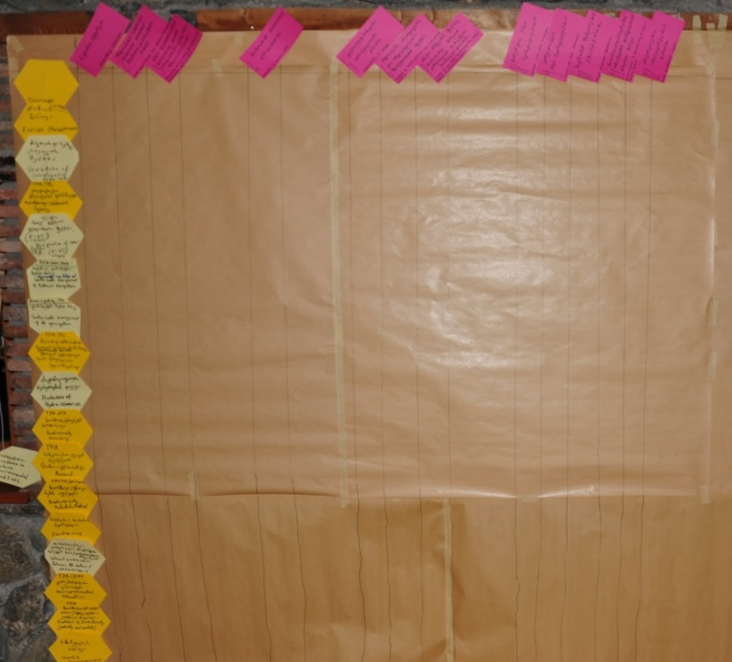
How are existing strategies assessed and prioritised?
3.
Along the left side, write or insert cards with the strategies which should be analyzed
Underneath each strategy, complement the grid with horizontal lines in-between the strategies
Existing and complementary strategies (Step 21) may be analyzed in two separate steps, or together (as pictured here)
Remember that darker yellow hexagons represent existing strategies while lighter yellow hexagons represent comple-mentary strategies
© Christina Lehmann 2015

Slide 15
How are existing strategies assessed and prioritised?
4.
Begin critical discussion among the participants
To analyze the impact, begin by asking what could cause the strategies to generate impacts different than those desired
→ Apply principles of Murphy’s Law: Assume that everything which can go wrong, will go wrong
5.
Develop worst-case scenarios of undesired consequences within the management area
→ Rather be pessimistic and foresee and prepare for the worst from the beginning than to realize negative impacts after strategies have already been implemented
→ Changing them would result in a loss of time and resources

Slide 16
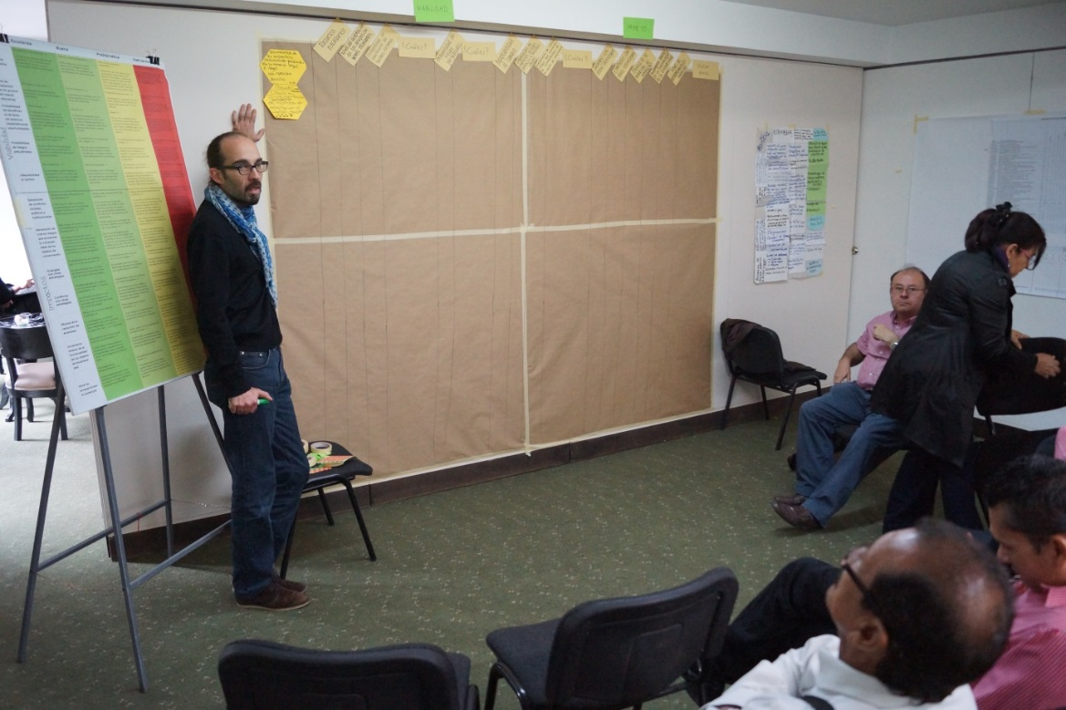
How are existing strategies assessed and prioritised?
6.
Using these scenarios as a baseline, rank each strategy according to the categories described later on
Useful: Have a table with the ranking criteria handy so participants can refer to it (MARISCO manual: p. 149-152)
Printed versions for distribution are helpful
© Pierre Ibisch 2014

Slide 17
How are existing strategies assessed and prioritised?
7.
In the boxes, apply appropriately colored sticker corresponding to each category
Repeat for all strategies
This is only a preliminary discussion
→ Where resources are available, in-depth analyses should be conducted
© Christina Lehmann 2015

Slide 18
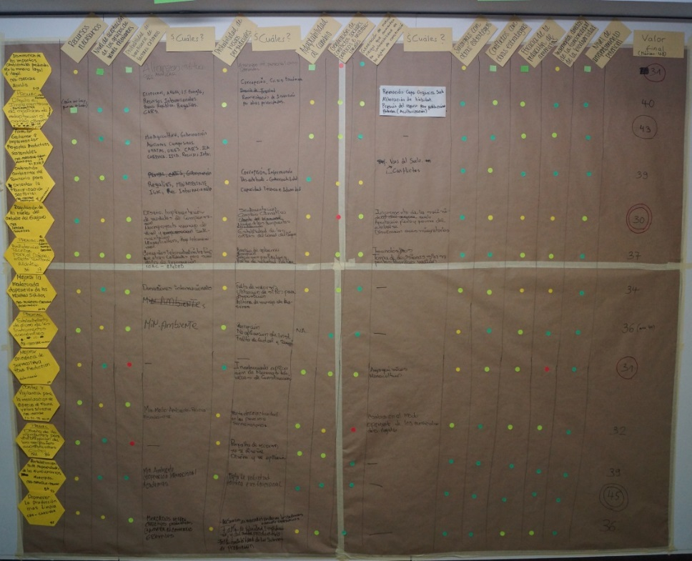
How are existing strategies assessed and prioritised?
8.
In the far right column, add together the resulting values of the analysis: Red = 1, Yellow = 2, Light Green = 3, Dark Green = 4
Strategies with the highest rankings tend to be the “best” strategies
Just because a strategy scores low on the ranking, does not mean it is not a worthwhile strategy
→ Some crucial strategies will rank quite low
Consider how low-ranking strategies can be altered/ implemented together with complementary strategies to improve their ranking score
© Pierre Ibisch 2014

Slide 19
How are existing strategies assessed and prioritised?
2) The evaluation of feasibility of existing strategies

Slide 20
How are existing strategies assessed and prioritised?
a) Necessary resources
Implementation of strategies requires different kinds of resources:
Strategy Implementation
Time
Financial Support
Knowledge
Personal
Proper combinations of resources are important
Although sufficient funding may be available, without the knowledge to properly plan strategies it is likely to be wasted

Slide 21
How are existing strategies assessed and prioritised?
Necessary resources
The following table is used to determine the availability of resources:
© CEEM 2014
The rating is marked with a sticker of corresponding color on the summary table of existing strategies
© Christina Lehmann 2015

Slide 22
How are existing strategies assessed and prioritised?
b) Level of acceptance from potential stakeholders
Conservation strategies affect many stakeholders
→ Successful implementation of a strategy is directly dependent on the willingness of stakeholders to accept it
Their willingness depends on the potential harms or benefits the strategy poses to them
→ Important to begin by considering the effects of planned strategies, both positive and negative
It is important to envision worst-case scenarios in order to develop robust strategies and to understand the mentalities of the stakeholders

Slide 23
How are existing strategies assessed and prioritised?
b) Level of acceptance from potential stakeholders
All stakeholders who will be affected should be listed
Their level of acceptance should be ranked using the following table:
© CEEM 2014
The rating is marked with a sticker of corresponding color on the summary table of existing strategies
© Christina Lehmann 2015

Slide 24
How are existing strategies assessed and prioritised?
c) Probability of benefitting from external factors (esp. opportunities)
Successful implementation of a strategy is not solely reliant on the capabilities of the management team
→ External factors can also play an important role
Sometimes opportunities can favour or support the imple-mentation of a strategy
E.g. highly flexible political situations can promote new laws or programs which directly benefit the implementation of strategies for ecosystem-based conservation
Other opportunities include additional funding or collaboration with institutions which are tackling similar problems

Slide 25
How are existing strategies assessed and prioritised?
c) Probability of benefitting from external factors (esp. opportunities)
Determine the probability that external factors which could benefit the strategy will occur
© CEEM 2014
The rating is marked with a sticker of corresponding color on the summary table of existing strategies
In the table, note down the relevant opportunities or resources
© Christina Lehmann 2015

Slide 26
How are existing strategies assessed and prioritised?
d) Probability of harmful risks
Not all flexible situations will provide benefits
Risk may be posed to the effectiveness of conservation strategies
E.g. insecure political situations can result in cancellation of planned funding or a decreased interest in ecosystem-based nature conservation
Among others, extreme weather events and unfavorable economic investments can jeopardize the potential for implementation of a strategy

Slide 27
How are existing strategies assessed and prioritised?
d) Probability of harmful risks
The table below provides the selection criteria for the probability of harmful risks
This is based on the probability that they will occur together with the expected potential magnitude of their impact
© CEEM 2014
The rating is marked with a sticker of corresponding colour on the summary table of existing strategies
In the table, note down the relevant risks
© Christina Lehmann 2015

Slide 28
How are existing strategies assessed and prioritised?
e) Adaptability to change
Uncertainty and unexpected changing circumstances are the foundations upon which management strategies must be built
Developing versatile strategies which respond adaptively to altered conditions supports the overall risk and vulnerability management of the conservation site
E.g., strategies that involve the construction of buildings are often less adaptable than ‘soft strategies,’ such as those related to communication

Slide 29
How are existing strategies assessed and prioritised?
e) Adaptability to change
Use the table below to develop the adaptability of the strategy:
© CEEM 2014
The rating is marked with a sticker of corresponding color on the summary table of existing strategies
© Christina Lehmann 2015

Slide 30
How are existing strategies assessed and prioritised?
3) The evaluation of impact of existing strategies

Slide 31
How are existing strategies assessed and prioritised?
a) Causation of social, political and institutional conflicts
It is important that stakeholders engage in the strategy implementation process
It sometimes occurs that conservation objectives conflict with stakeholders’ socio-economic interests
Possible conflicts could include those over land tenure or rights, the increase or removal of subsidies or incentives, etc.
Notes:
Pictures: Prof. Dr. Pierre Ibisch

Slide 32
How are existing strategies assessed and prioritised?
a) Causation of social, political and institutional conflicts
E.g., strategies which set aside portions of land to protect sensitive species directly interfere with some farmer’s ability to use the land to produce food they need to sustain themselves
→ They may perceive the strategies as disproportionately negatively affecting them and form an association demanding their lands to be returned to them
→ Other stakeholders, such as those responsible for processing harvested goods, shopkeepers and others affected by this decrease in production, may join in
This could increase existing conflicts between stakeholders and institutions or create new ones
Notes:
Pictures: Prof. Dr. Pierre Ibisch

Slide 33
How are existing strategies assessed and prioritised?
a) Causation of social, political and institutional conflicts
Evaluate the probability that institutional conflicts will arise after the strategy has been delivered according to the following table:
© CEEM 2014
The rating is marked with a sticker of corresponding color on the summary table of existing strategies
© Christina Lehmann 2015

Slide 34
How are existing strategies assessed and prioritised?
b) Causation of new risks that increase the vulnerability of conservation objects
Although a thorough analysis has been carried out, it is likely that there are elements of the ecosystem which are not fully understood
During the implementation process, faulty assumptions may become evident through unexpected reactions of some system components, worsening or creating new stresses and threats
Notes:
Pictures: Prof. Dr. Pierre Ibisch

Slide 35
How are existing strategies assessed and prioritised?
b) Causation of new risks that increase the vulnerability of conservation objects
Evaluate the likelihood of strategies to result in biophysical damages in the management area or direct harm to biodiversity objects using the following table:
© CEEM 2014
The rating is marked with a sticker of corresponding color on the summary table of existing strategies
© Christina Lehmann 2015

Slide 36
How are existing strategies assessed and prioritised?
c) Synergies with other strategies
Synergistic effects: Occur when strategies are carefully constructed to work in an integrative way with other objectives and activities within the planned area
E.g., a strategy promoting the social and political organization of local communities can develop significant synergies with communication strategies or the enforcement of legal regulations
Notes:
Pictures: Prof. Dr. Pierre Ibisch

Slide 37
How are existing strategies assessed and prioritised?
c) Synergies with other strategies
The probability of developing synergies with other strategies can be analysed using the following table:
© CEEM 2014
The rating is marked with a sticker of corres-ponding color on the summary table of existing strategies
© Christina Lehmann 2015

Slide 38
How are existing strategies assessed and prioritised?
d) Conflicts with other strategies
Some strategies will work directly against other strategies, causing an overall reduction in the effectiveness of the strategic program
E.g., a strategy that improves living conditions in the management area may lead to immigration to the area
→ Direct conflict with strategies which target human population growth
After identification, changes to counter the identified conflicts must be made
Notes:
Pictures: Prof. Dr. Pierre Ibisch

Slide 39
How are existing strategies assessed and prioritised?
d) Conflicts with other strategies
Both, conflicts which already exist between strategies and those which could develop should be assessed according to the following table:
© CEEM 2014
The rating is marked with a sticker of corresponding color on the summary table of existing strategies
© Christina Lehmann 2015

Slide 40
How are existing strategies assessed and prioritised?
e) Threat abatement effectiveness
Degree to which a threat is alleviated or avoided by the implementation of a strategy
This step promotes critical reflection of the real impact of strategies on threats
This is not a measure of the efficiency (the cost-effect ratio) nor the effectiveness (the accomplishment of defined objectives within the defined timeframe) of the strategy
→ Measure of the success of strategies to decrease the vulnerability of the conservation objects by directly tackling the threats outlined in the conceptual model
Notes:
Pictures: Prof. Dr. Pierre Ibisch

Slide 41
How are existing strategies assessed and prioritised?
e) Threat abatement effectiveness
Use the following table to gauge the effectiveness of strategies in treating threats:
© CEEM 2014
The rating is marked with a sticker of corresponding color on the summary table of existing strategies
© Christina Lehmann 2015

Slide 42
How are existing strategies assessed and prioritised?
f) Direct increases in biodiversity functionality
Some strategies are designed to directly enhance the functionality of a biodiversity object or at least restore it to an acceptable level of functionality
This stage tries to assess the potential change and hopefully increase in functionality of a biodiversity object that has been subjected to the actions of a strategy
Notes:
Pictures: Prof. Dr. Pierre Ibisch

Slide 43
How are existing strategies assessed and prioritised?
f) Direct increases in biodiversity functionality
Use the following table to rate the impact a strategy on biodiversity functionality:
© CEEM 2014
The rating is marked with a sticker of corresponding color on the summary table of existing strategies
© Christina Lehmann 2015

Slide 44
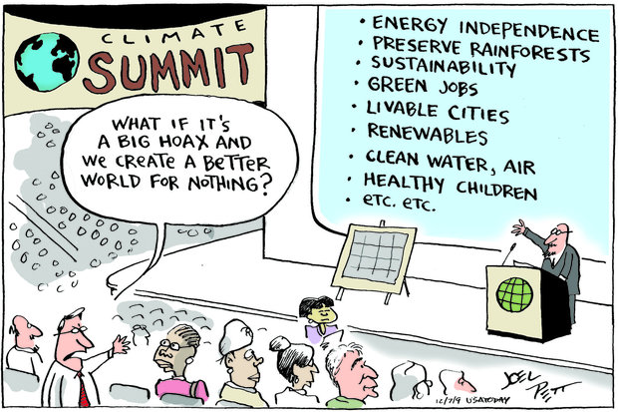
How are existing strategies assessed and prioritised?
g) Level of potential regret
Strategies may not achieve their intended impacts, but they may still generate secondary positive impacts
Therefore, the failure of a strategy does not imply a total waste of invested resources
In the case where there are secondary positive effects, the strategy would be a low- or no-regret option
© Joel Pett 2009
Notes:
http://www.climateactionreserve.org/blog/2012/08/31/environmental-cartoons-by-joel-pett/

Slide 45
How are existing strategies assessed and prioritised?
g) Level of potential regret
Use the following table to assess the potential level of regret:
The rating is marked with a sticker of corresponding color on the summary table of existing strategies
© Christina Lehmann 2015

Slide 46
Practical Tips
Avoid wishful thinking!
→ Just because a strategy needs to work does not mean that it will
Some groups might need some encouragement during this step as it is very labour-intensive
→ Often it is only few participants working while others watch or stand besides try to get them back into the process and stress the importance of this step as it is crucial for the actual implementation of strategies

