Slide 1
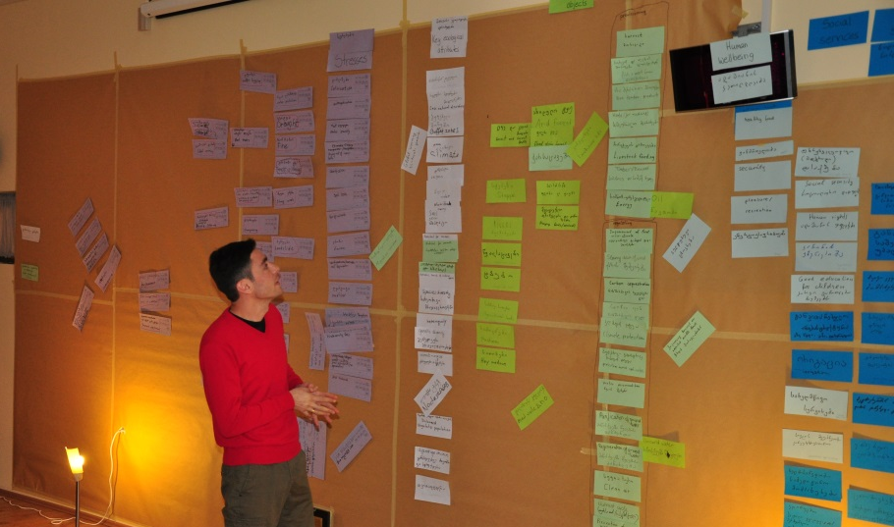
Assessment of the current status of the biodiversity objects
© Christina Lehmann 2014
Phase II
Systemic Vulnerability and Risk Analysis
Step 5

Slide 2
Credits and conditions of use
© Centre for Econics and Ecosystem Management, 2014
The Centre for Econics and Ecosystem Management strongly recommends that this presentation is given by experts familiar with the adaptive management process in general (especially as designed as the Conservation Measures Partnership’s Open Standards for the Practice of Conservation) as well as the MARISCO Method itself.
You are free to share this presentation and adapt it for your use under the following conditions:
You must attribute the work in the manner specified by the authors (but
not in any way that suggests that they endorse you or your use of the work).
You may not use this work for commercial purposes.
If you alter, transform, or build upon this work, you must remove the Centre for
Econics and Ecosystem Management logo, and you may distribute the resulting work
only under the same or similar conditions to this one.
This material was created under the leadership and responsibility of Prof. Dr. Pierre Ibisch and Dr. Peter Hobson, co-directors of the Centre for Econics and Ecosystem Management, which was jointly established by Eberswalde University for Sustainable Development and Writtle College. Compare: Ibisch, P.L. & P.R. Hobson (eds.) (2014): The MARISCO method: Adaptive MAnagement of vulnerability and RISk at COnservation sites. A guidebook for risk-robust, adaptive, and ecosystem-based conservation of biodiversity. Centre for Econics and Ecosystem Management, Eberswalde (ISBN 978-3-00-043244-6). 195 pp. - The Powerpoint Presentation was conceived by Christina Lehmann and Pierre Ibisch. Authors of graphs and photographs are indicated on the corresponding slides. Supported by the Deutsche Gesellschaft für Internationale Zusammenarbeit (GIZ) GmbH on behalf of the Bundesministerium für wirtschaftliche Zusammenarbeit und Entwicklung (BMZ).

Slide 4
Learning objectives
Participants have a clear understanding of the terms “key ecological attribute” and “stress”.
They recognize and are able to explain the use of defining and assessing key ecological attributes and stresses in order to assess the actual status of the biodiversity conservation object`s functionality.
Furthermore, participants have the skills to facilitate the process of identifying relevant key ecological attributes, identifying good indicators to measure their actual status and determining their desired future status.
Participants have the knowledge and skills to identify relevant stresses to conservation objects with a team as well as to explain the role of key ecological attributes and stresses in assessing the vulnerability of the conservation objects.

Slide 5
Outline
What is the assessment of the current status of biodiversity objects?
Why do we assess the current status of the biodiversity objects?
How do we assess the current status of the biodiversity objects? Part a) Determination of key ecological attributes and functionality of the target systems Part b) Identification of current stresses that reduce the viability and integrity of the
biodiversity targets
Practical Tips

Slide 6
What is the assessment of the current status of biodiversity objects?
First part of the Systemic vulnerability and risk analysis
Identification of more concrete elements that ensure the efficient and resilient functionality of ecosystems
Key ecological attributes relate to respective biodiversity objects
Stresses are the experienceable degradation of key ecological attributes

Slide 7
Functionality of an Ecosystem
… is a certain state of a system that is characterised by biological and ecological interactions of components that contribute to the system‘s efficiency and resilience
No stress = high functionality = resilient
Low functionality of a system = system prone to shift and change
High functionality of a system = „healthy“ system
Conservation goal
To be mentioned:
In reality, a certain level of disturbance and corresponding stress is always driving the evolution and adaption of biological and ecological systems (and is even needed so they can develop their adaptive capacity).

Slide 8
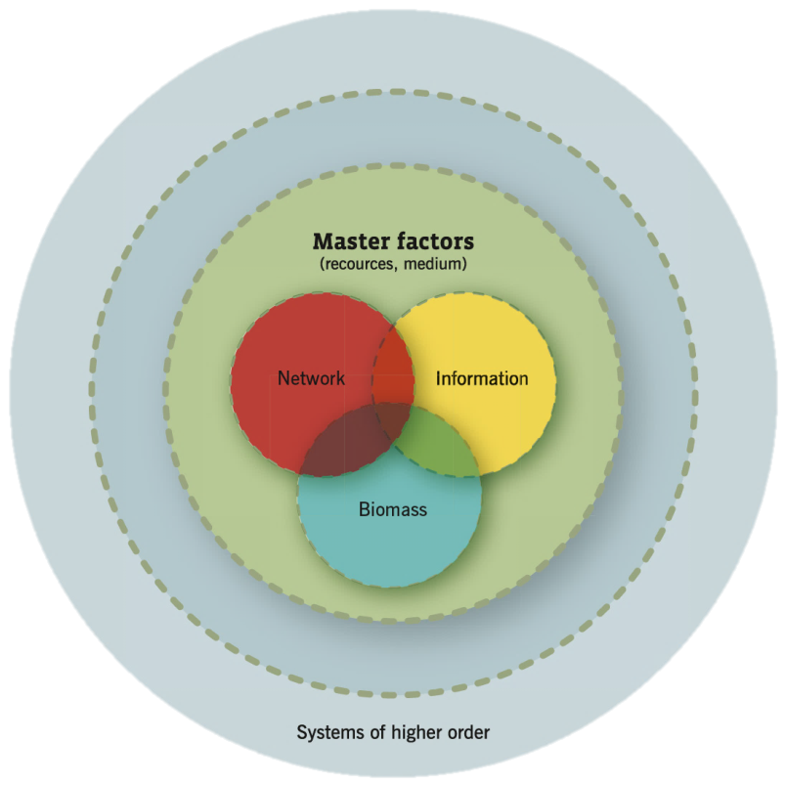
Key Ecological Attributes
Basic elements and properties of ecological systems
They maintain function and provide necessary adaptation and resilience to cope with perturbations
They relate to:
Master factors → energy input, moisture,
temperature, nutrients
Biomass
Networks
Information

Slide 9
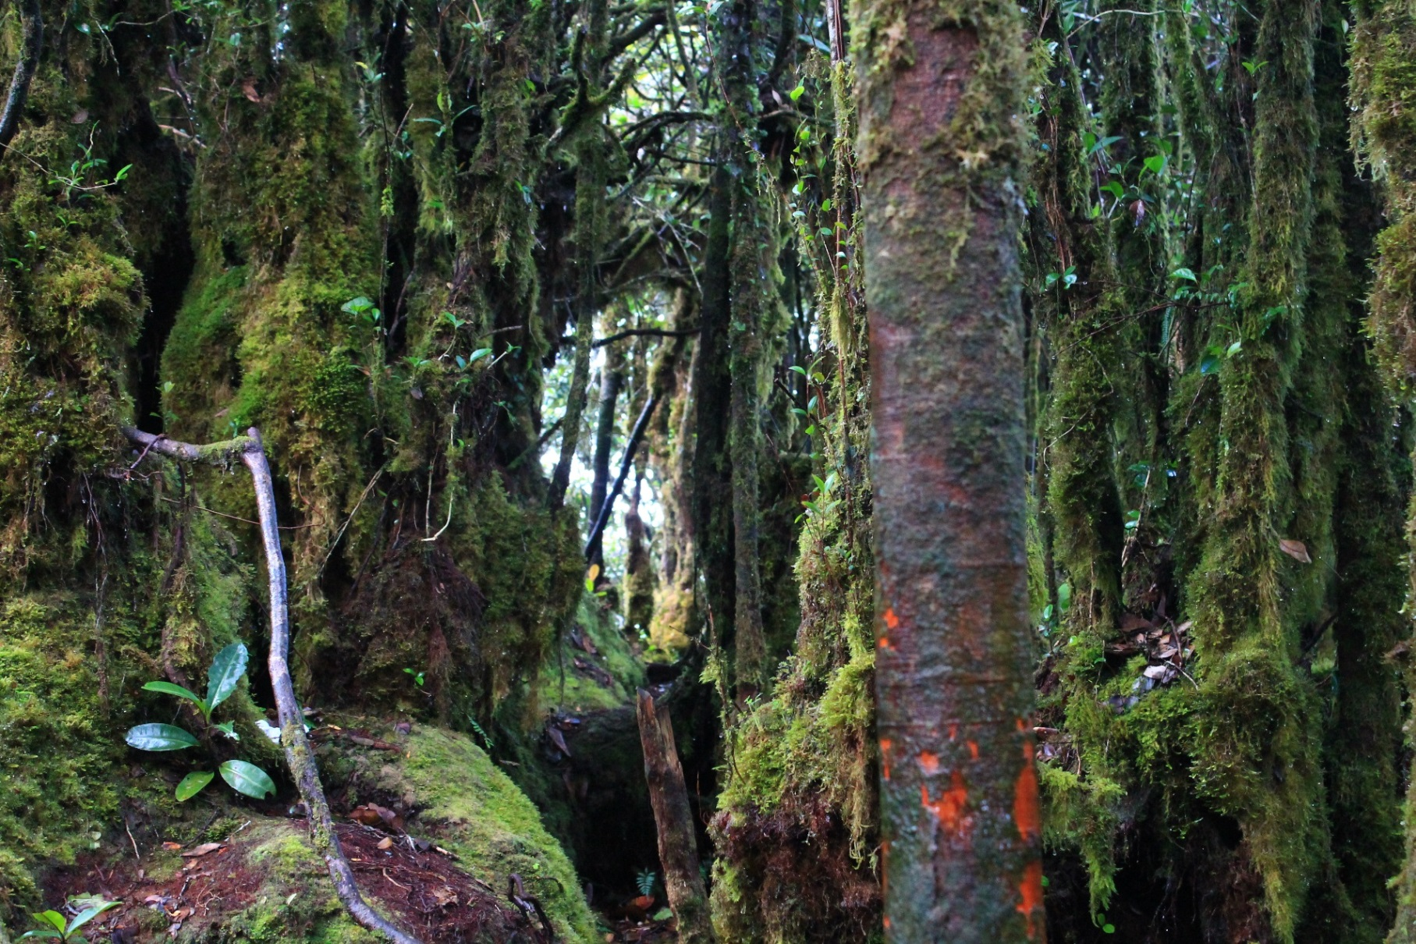
Key Ecological Attributes
Biomass:
Trees,
Mosses, Flowers,
Fungi,
Dead Matter
Information:
Gene Pool
Nutrient Uptake
Nutrient Provision
Network:
Mycorrhizal Symbiosis,
Nutrient Exchange
© Christina Lehmann 2012
Notes:
Pictures: Christina Lehmann 2014

Slide 10
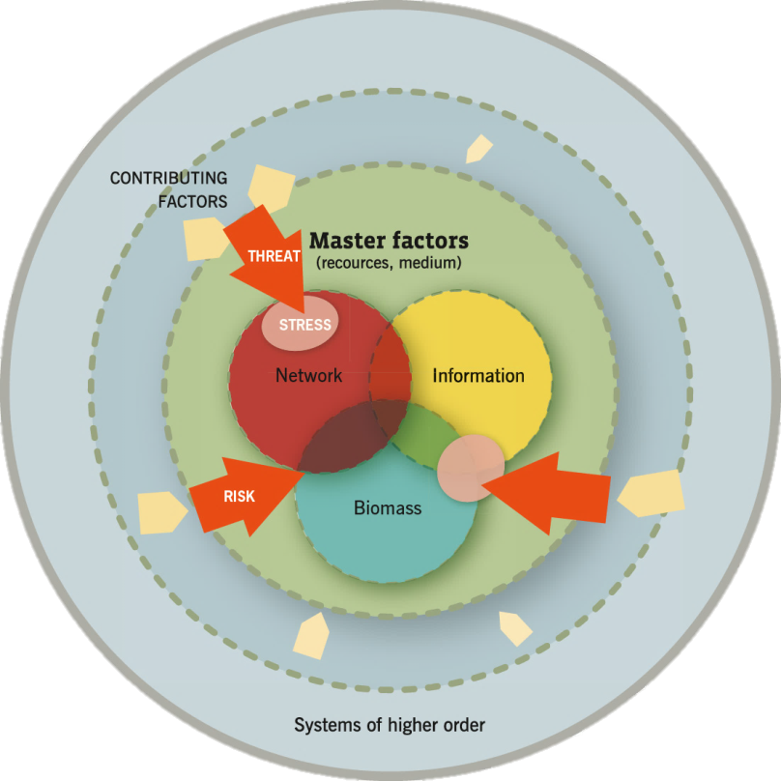
Stresses
Caused by threats
Visible symptoms & mani-festations of degradation of key ecological attributes
Loss of minimum levels of biomass, information and network due to insufficient availability or quality of master factors
Result: Negative impact on resilience and adaptive capacity of biodiversity elements
If stress is sustained → shifts or changes in system

Slide 11
Stresses
Metaphor of a medical doctor and his examination of the patient
It is the wound/ injury/ change of the body that is visible

Slide 12
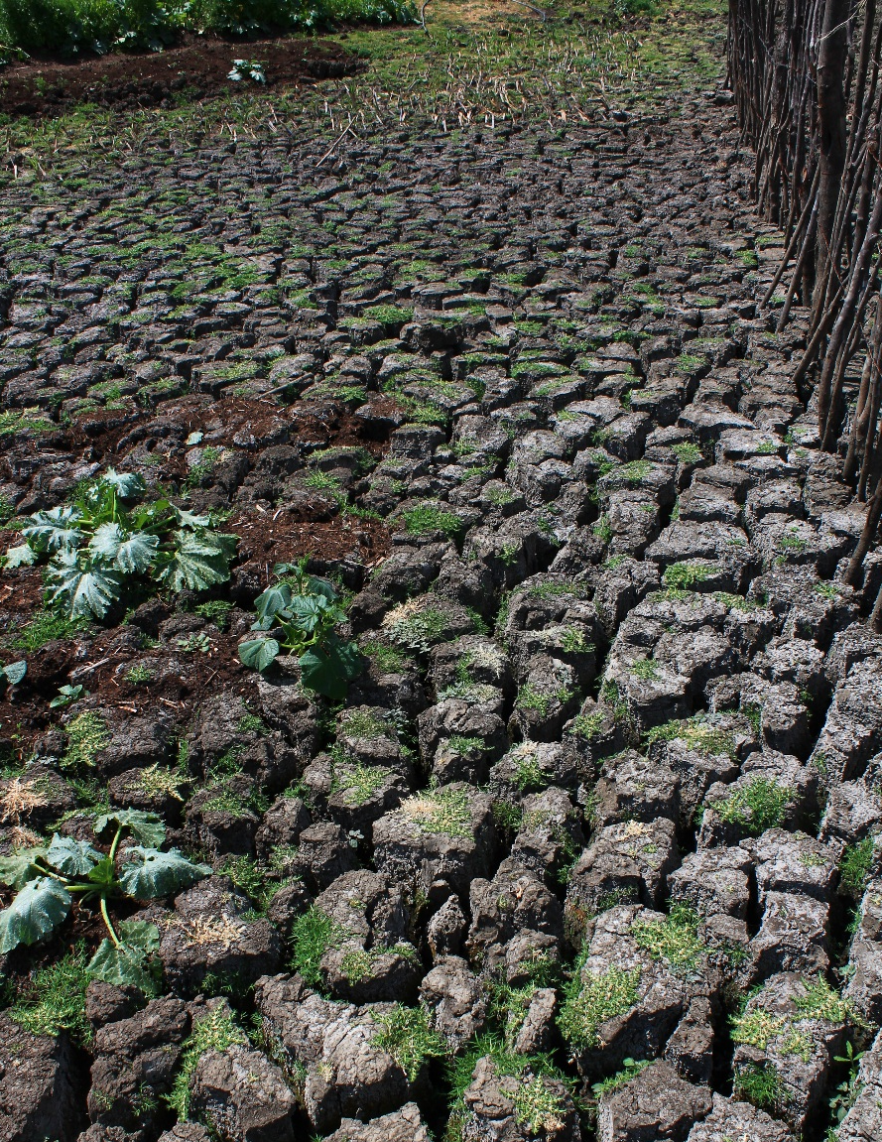
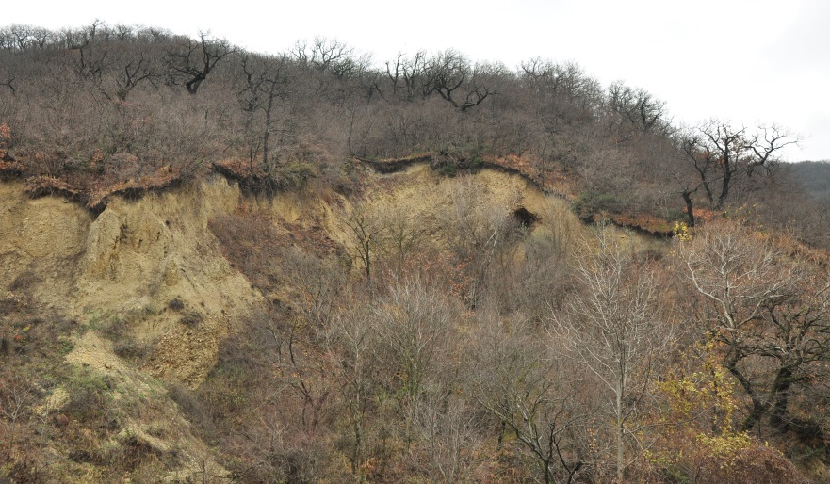
Stresses
© Pierre Ibisch 2014
© Christoph Nowicki 2014
© Christina Lehmann 2012
Notes:
Pictures: Christina Lehmann 2012 & 2014

Slide 13
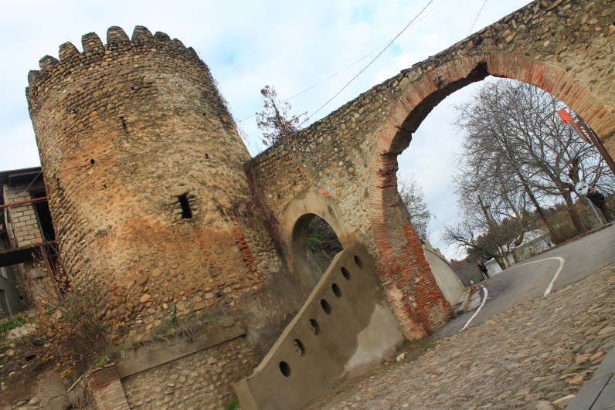
Why do we assess the current status of the biodiversity objects?
Assessment as basis for strategies to improve or at least maintain the functionality of the ecosystem
Create a comprehensive bridge between the ecosystem/ its elements and the stresses they are facing → build understanding for the necessity of conservation
© Christina Lehmann 2014
Notes:
Pictures: MARISCO Manual 2014

Slide 14
How do we assess the current status of the biodiversity objects?
Part a)
Determination of key ecological attributes and functionality of the target systems
Assessment follows 3 basic guiding principles
„Nature knows best“ Do not assume that there are better/more efficient ways of driving function and dynamics in natural ecosystems
Identify and correct negative anthropogenic influence that cause unnatural loss and change
Build natural but compromising strategies → natural character of original parent ecosystem + communities‘ needs and dependencies

Slide 15
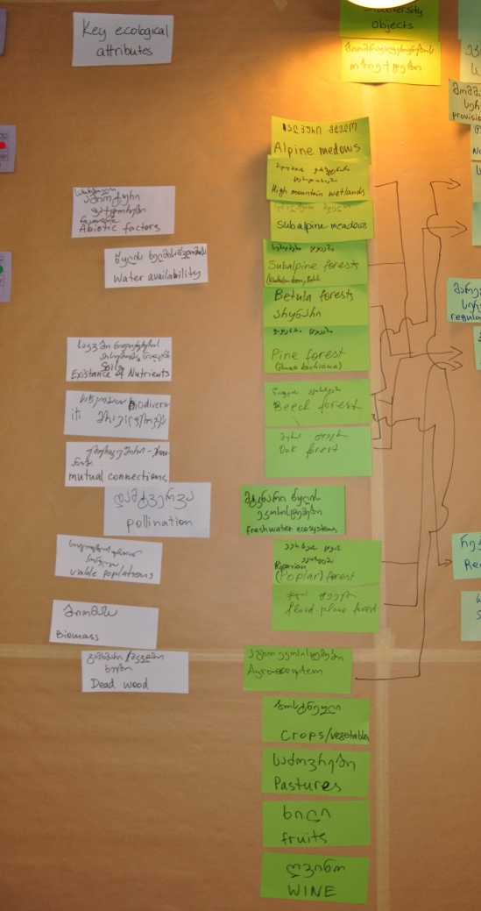
How do we assess the current status of the biodiversity objects?
Identification of key ecological attributes for all biodiversity objects
List them on white cards
For each biodiversity object in individual working groups or in plenary discussion possible
Categorisation of KEA according to main categories (master factors, biomass, information, network) with scientifically experienced groups possible
© Christoph Nowicki 2014

Slide 16
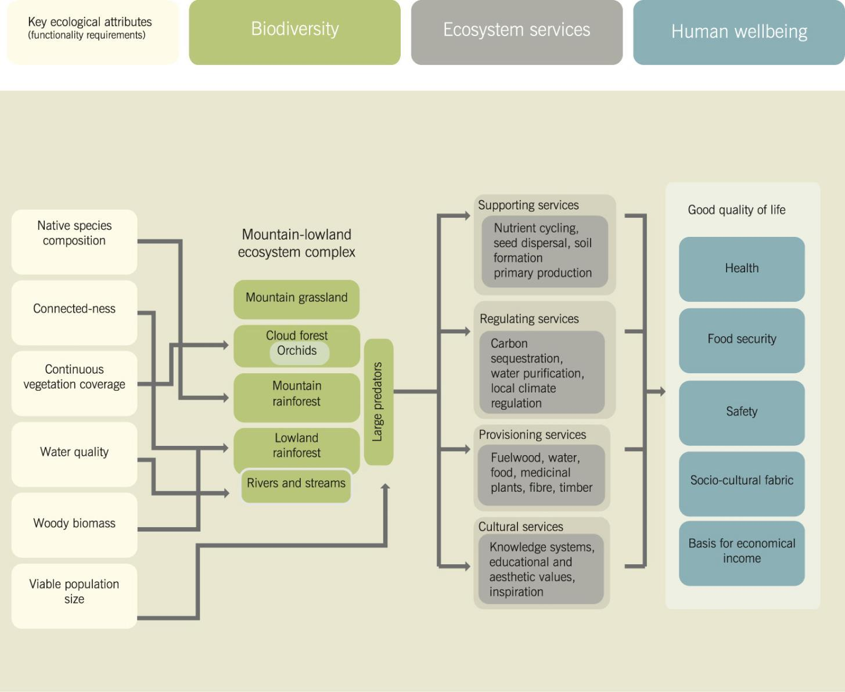
How do we assess the current status of the biodiversity objects?
© CEEM 2014

Slide 17
How do we assess the current status of the biodiversity objects?
Guiding questions for identification of key ecological attributes
Which key characteristics are required for the functionality of the biodiversity object?
Which key characteristics would lead to the loss or total degradation of a biodiversity object when altered or missing?
Which key characteristics are required to ensure resilience of a biodiversity object and for it to have a certain adaptive and buffering capacity against disturbance and environmental change?

Slide 18
How do we assess the current status of the biodiversity objects?
Define indicators to measure the status of the key ecological attributes
At least 1 indicator per attribute
Measurability of generated indicators necessary
Limit number of indicators to most significant and cost-effective ones
In case of time and resource constraints → attention to representation of bigger systems within project area

Slide 19
How do we assess the current status of the biodiversity objects?
S-U-M criteria for good indicators
Sensitive: The change in indicator values must consistently correlate with changes in the condition to be managed, without showing any changes over time.
Unambiguous: It is clear from the evidence and understanding that the indicator relates directly to the condition to be managed.
Measurable: Possibility to take reliable measurements with reasonably simple and costefficient equipment or methods necessary.

Slide 20
How do we assess the current status of the biodiversity objects?
Establish an accaptable range of variation and a rating scale for indicators
Natural variation as part of oscillation and dynamics of an ecosystem
Check out: Holling
© Holling 2001
Notes:
C.S. Holling (2001): Understanding the Complexity of Economic, Ecological, and Social Systems. Ecosystems (4). S.390-405.
ftp://200.89.74.94/pub/Docencia/Sistemas_ecosociales/Literatura/Clase_1/Holling2001.pdf

Slide 21
How do we assess the current status of the biodiversity objects?
Consider ranging of indicators to categorise them → establish rating scale
Rating scale created through initial distinction of 2 states (eg. Very good/good and fair/poor) and further splitting afterwards (e.g. very good = 4; good = 3; fair = 2; poor = 1)
Natural variation is acceptable when very good or good
Alert when indicators are below good
© CEEM 2014

Slide 22
How do we assess the current status of the biodiversity objects?
Guiding questions for the identification of range of variation
How much alteration in an indicator is acceptable/too much for a biodiversity object?
How much restoration is enough?
Tipping point reached?

Slide 23
How do we assess the current status of the biodiversity objects?
To be mentioned:
Do not flounder at this stage of categorisation – as the emphasis of MARISCO lies on adaptive-management planning and knowledge mapping even in mediocre circumstances, alterations at a later point are possible.
?

Slide 24
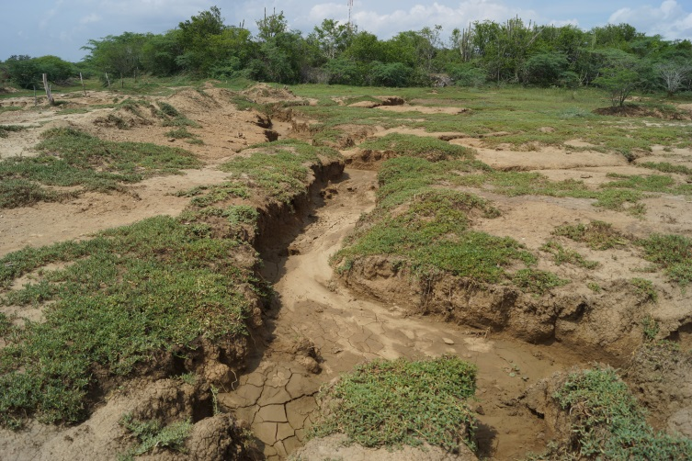
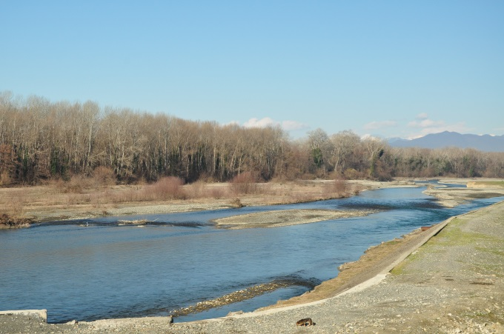
How do we assess the current status of the biodiversity objects?
Determine the current and desired future status
Provide indication of the current status (proxy data of indicators objectively collected or subjectively estimated)
Project visionary future status of key ecological attributes → what status should the attribute be in after management strategies have been applied?
© Pierre Ibisch 2014
© Christoph Nowicki 2015

Slide 25
How do we assess the current status of the biodiversity objects?
Part b)
Identification of current stresses that reduce the viability and integrity of the biodiversity targets
Rationale: Understanding of how target systems are affected by threats
Analysis and assessment of stresses of biodiversity objects according to considered key ecological attributes
= Reflection on health of biodiversity objects
Clustering of stresses and construction cause-effect-chains within „stress-network“ to identify most critical stresses
© Christoph Nowicki 2014

Slide 26
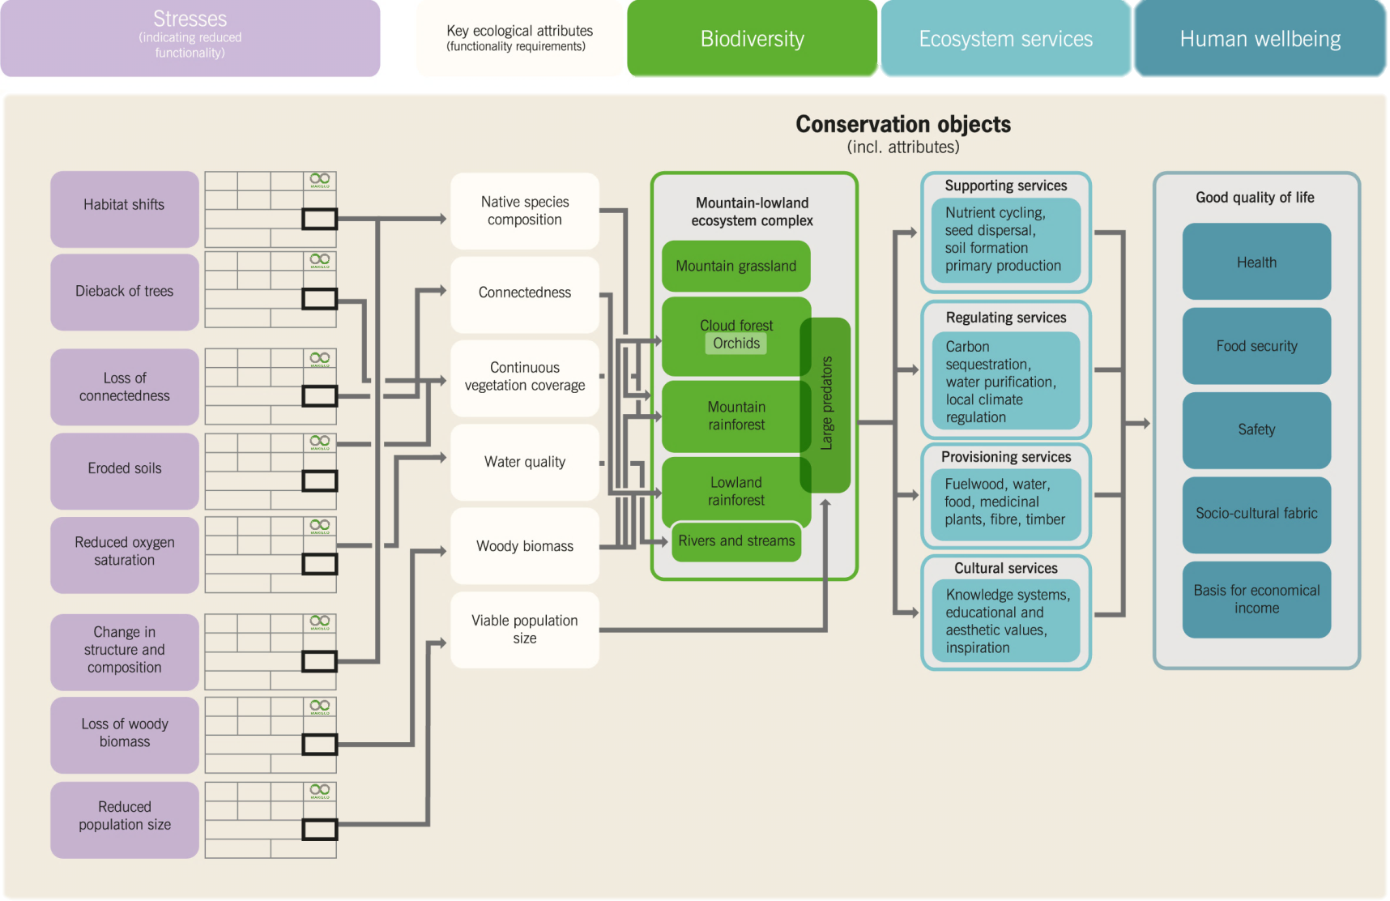
How do we assess the current status of the biodiversity objects?
© CEEM 2014

Slide 27
How do we assess the current status of the biodiversity objects?
Use: purple rectangular „MARISCO stress cards“
© CEEM 2014

Slide 28
How do we assess the current status of the biodiversity objects?
Guiding questions to identify stresses
What kind of negative changes can be observed happening in the biodiverstiy object?
What are the signs of „disorder“ and „illness“?
Are there any critical changes to the status of environmental master factors, such as climate, soils or water?
Is there a loss of biomass, information or network within the system?
Is there a loss of network/ connectedness with other systems?

Slide 29
Practical Tips
Try to define indicators as clearly as possible to avoid confusions while rating them
It is crucial to focus concretely on the elements that are central and the function they carry in the conceptual model and system
→ try to avoid overlappings with neighbouring categories like
„biodiversity objects“ or „threats“ because they confuse the
model and make working with it more difficult
→ You might want to explain the following steps a bit already as this will increase the understanding why certain negative influences on the ecosystem are NOT stresses but threats that cause stresses

