Slide 1
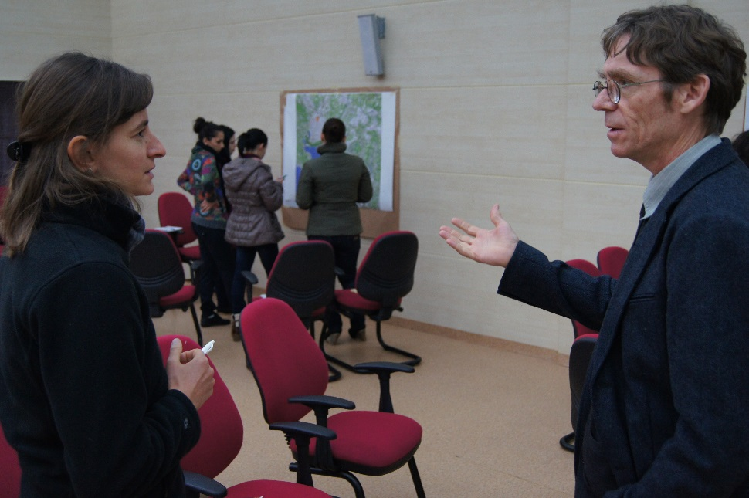
Organisation of institutional learning and sharing with other projects and initiatives
© Pierre Ibisch 2013
Phase IV
Implementation and (non)-knowledge management
Step 28

Slide 2
Credits and conditions of use
© Centre for Econics and Ecosystem Management, 2014
The Centre for Econics and Ecosystem Management strongly recommends that this presentation is given by experts familiar with the adaptive management process in general (especially as designed as the Conservation Measures Partnership’s Open Standards for the Practice of Conservation) as well as the MARISCO Method itself.
You are free to share this presentation and adapt it for your use under the following conditions:
You must attribute the work in the manner specified by the authors (but
not in any way that suggests that they endorse you or your use of the work).
You may not use this work for commercial purposes.
If you alter, transform, or build upon this work, you must remove the Centre for
Econics and Ecosystem Management logo, and you may distribute the resulting work
only under the same or similar conditions to this one.
This material was created under the leadership and responsibility of Prof. Dr. Pierre Ibisch and Dr. Peter Hobson, co-directors of the Centre for Econics and Ecosystem Management, which was jointly established by Eberswalde University for Sustainable Development and Writtle College. Compare: Ibisch, P.L. & P.R. Hobson (eds.) (2014): The MARISCO method: Adaptive MAnagement of vulnerability and RISk at COnservation sites. A guidebook for risk-robust, adaptive, and ecosystem-based conservation of biodiversity. Centre for Econics and Ecosystem Management, Eberswalde (ISBN 978-3-00-043244-6). 195 pp. - The Powerpoint Presentation was conceived by Jamie Call, Christina Lehmann and Pierre Ibisch. Authors of graphs and photographs are indicated on the corresponding slides. Supported by the Deutsche Gesellschaft für Internationale Zusammenarbeit (GIZ) GmbH on behalf of the Bundesministerium für wirtschaftliche Zusammenarbeit und Entwicklung (BMZ).

Slide 4
Learning objectives
Participants are able to organize a process of exchange and learning during the application of the planning process as well as to support the institutionalisation of sharing during the implementation phase.
Participants are able to create and pass the importance of having a friendly learning environment.

Slide 5
Outline
What is institutional learning?
Why do we engage in institutional learning and share with other projects and initiatives?
How do we organize institutional learning and inter-institutional sharing?
Practical Tips

Slide 6
What is institutional learning?
Institutional learning is constant learning occurring throughout the whole planning process
Outcomes are used for reflective analysis of what has worked and not worked
The lessons learned from the reflective analysis inform decisions about future directions
© Pierre Ibisch 2013
Notes:
Pictures: Prof. Dr. Pierre Ibisch

Slide 7
Why do we engage in institutional learning and share with other projects and initiatives?
Institutional learning augments the knowledge about the project site, the implementation methods and approaches
Allows institutions to specifically address mistakes, unforeseen aspects, wrong assumptions and creative solutions
Supports ongoing analysis of the project site and promotes changes to improve effectiveness of strategies
Promotes active learning and participation in project team
Sharing knowledge provides basis for inter-institutional collaboration
Saves time and resources by allowing organizations to learn from mistakes and success of others without having to try everything firsthand
© Pierre Ibisch 2013

Slide 8
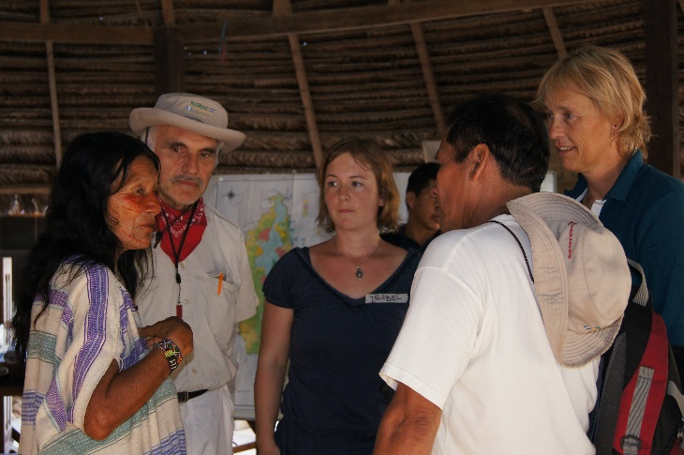
How do we organize institutional learning and inter-institutional sharing?
Gathering all members of the management project team
→ Internal exchange about the course of the management process and functioning, structure and development of the managing entity
→ Can only be successful if unbiased analysis can be carried out
Parties must be willing to critique existing management practices in order to adapt them, when necessary
Quality of institutional learning will improve as project teams develop ability to give and receive constructive criticism and effect-tively communicate face-to-face
Each organization will have a preferred method how to integrate learning processes into daily work routine
© Pierre Ibisch 2011

Slide 9
Practical Tips
Actively seek to have the different parties meet and exchange their knowledge
→ More people than only the planning team may profit from it

