Slide 1


Monitoring of results, impacts and research
© CEEM 2014
Phase IV
Implementation and (non)-knowledge management
Step 26

Slide 2
Credits and conditions of use
© Centre for Econics and Ecosystem Management, 2014
The Centre for Econics and Ecosystem Management strongly recommends that this presentation is given by experts familiar with the adaptive management process in general (especially as designed as the Conservation Measures Partnership’s Open Standards for the Practice of Conservation) as well as the MARISCO Method itself.
You are free to share this presentation and adapt it for your use under the following conditions:
You must attribute the work in the manner specified by the authors (but
not in any way that suggests that they endorse you or your use of the work).
You may not use this work for commercial purposes.
If you alter, transform, or build upon this work, you must remove the Centre for
Econics and Ecosystem Management logo, and you may distribute the resulting work
only under the same or similar conditions to this one.
This material was created under the leadership and responsibility of Prof. Dr. Pierre Ibisch and Dr. Peter Hobson, co-directors of the Centre for Econics and Ecosystem Management, which was jointly established by Eberswalde University for Sustainable Development and Writtle College. Compare: Ibisch, P.L. & P.R. Hobson (eds.) (2014): The MARISCO method: Adaptive MAnagement of vulnerability and RISk at COnservation sites. A guidebook for risk-robust, adaptive, and ecosystem-based conservation of biodiversity. Centre for Econics and Ecosystem Management, Eberswalde (ISBN 978-3-00-043244-6). 195 pp. - The Powerpoint Presentation was conceived by Jamie Call, Christina Lehmann and Pierre Ibisch. Authors of graphs and photographs are indicated on the corresponding slides. Supported by the Deutsche Gesellschaft für Internationale Zusammenarbeit (GIZ) GmbH on behalf of the Bundesministerium für wirtschaftliche Zusammenarbeit und Entwicklung (BMZ).

Slide 3
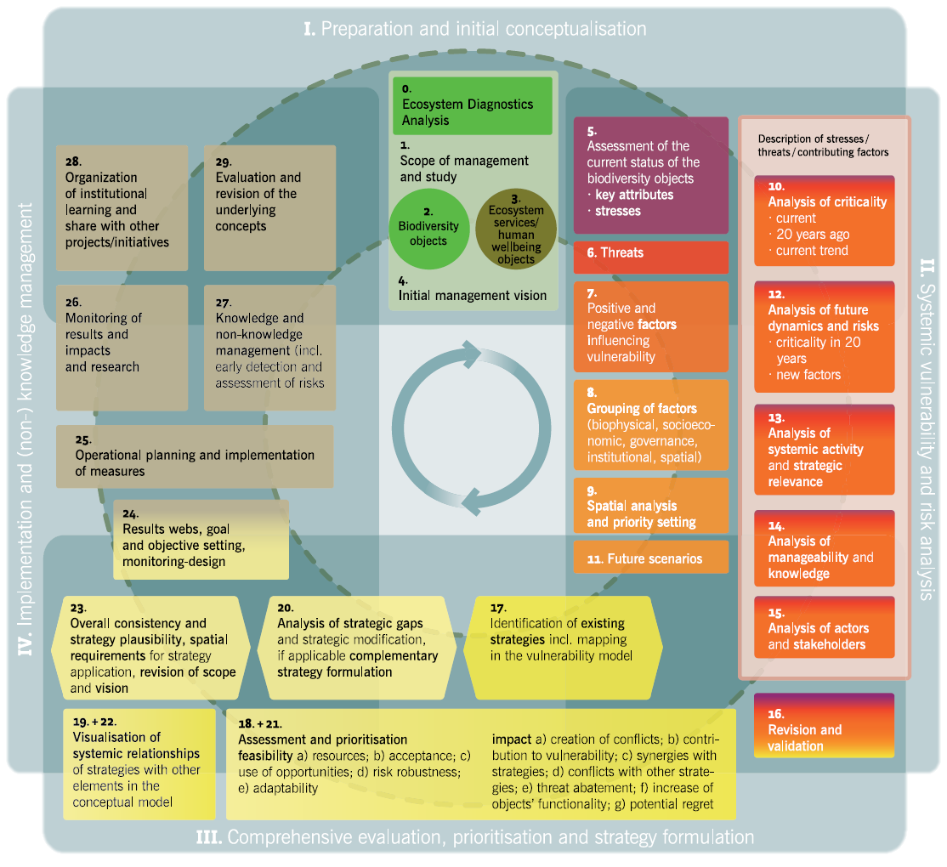

Slide 4
Learning objectives
Participants know relevant contents of this step and are able to accompany the monitoring of the operational activities as well as of the outcomes and effects of the strategies.
They are furthermore able to guide a project team towards closing knowledge gaps by designing and implementing research as well as to use the monitoring as an early-warning system.

Slide 5
Outline
  What is results and impact monitoring?
Why do we monitor results and impacts as well as conduct further research?
How do we monitor results and impacts as well as conduct further research?
  Practical Tips

Slide 6
What is results and impact monitoring?
Monitoring is a process of measuring and documenting outcomes of the strategies realised
→ Also involves searching for and recognising potential risks which can jeopardize the conservation objects or implemented strategies
Stress
Strategy
Outcome 1
Outcome 2
Indicator a
Indicator b
Indicator a
Indicator b
Pworked
Pworked
Odid not work
Pworked
Notes:
Pictures: Prof. Dr. Pierre Ibisch

Slide 7
Why do we monitor results and impacts as well as conduct further research?
A good monitoring system acts as an early warning system
Alerts managers to changes in the system, potential strategy failures and the loss of functionality in the conservation objects
  Through early detection of problems, they can be mitigated or adapted to before they manifest themselves or threaten the system
Monitoring allows for tracking of outcomes of strategies to see if they are having their desired effects
Additional research helps to close knowledge gaps and blind spots that appeared during the conceptualization and planning phases
Stress
Strategy
Outcome 1
Outcome 2
Indicator a
Indicator b
Indicator a
Indicator b
Pworked
Pworked
Odid not work
Pworked

Slide 8
How do we monitor results and impacts as well as conduct further research?
The process of monitoring is planned and documented through the monitoring plan described in Step 24

Slide 9
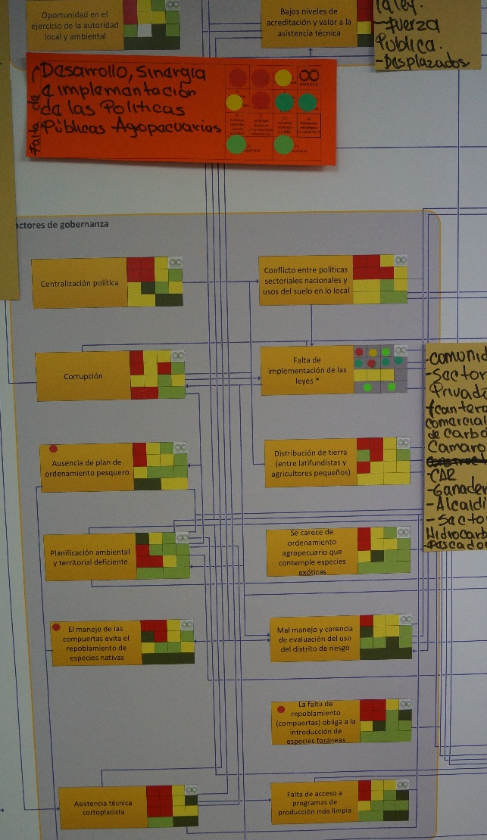
How do we monitor results and impacts as well as conduct further research?
To increase knowledge: elements of the conceptual model which had a light green, yellow or red ranking provide a good starting point
→ These rankings mean that there is currently not much known about the elements, but it is possible to find out
Design, implement or delegate structured research
Leave space in the conceptual model to insert new information as it becomes available
Do not get too carried away tracking the ramifications of one specific investigated element
© Pierre Ibisch 2014

Slide 10
Practical Tips
Monitoring the results and comparing them with the former desired outcomes is a main aspect of adaptive management
→ Even though it might not be part of the “booked” MARISCO process, try to encourage participants and experts to exercise this step
→ Only way to make improvements sustainable
Stress
Strategy
Outcome 1
Outcome 2
Indicator a
Indicator b
Indicator a
Indicator b
Pworked
Pworked
Odid not work
Pworked
New strategy?

