Slide 1
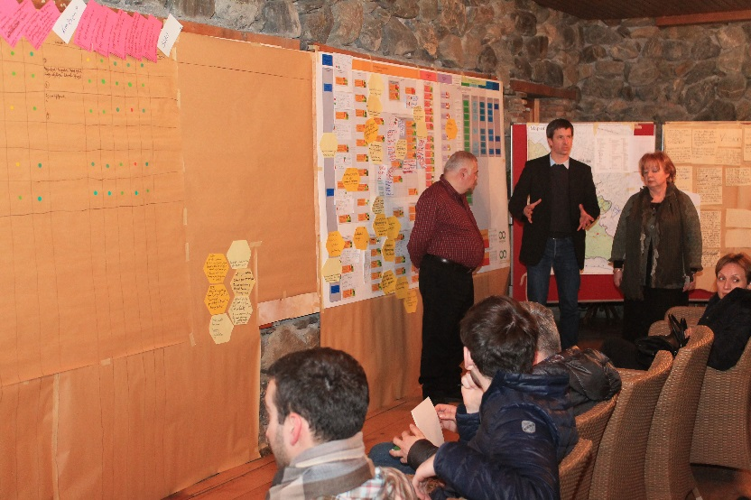
The overall consistency and plausibility of strategies, the spatial requirements for strategy implementation, and the revision of the management scope and vision
© Christina Lehmann 2015
Phase III
Comprehensive evaluation, prioritization and strategy formulation
Step 23

Slide 2
Credits and conditions of use
© Centre for Econics and Ecosystem Management, 2014
The Centre for Econics and Ecosystem Management strongly recommends that this presentation is given by experts familiar with the adaptive management process in general (especially as designed as the Conservation Measures Partnership’s Open Standards for the Practice of Conservation) as well as the MARISCO Method itself.
You are free to share this presentation and adapt it for your use under the following conditions:
You must attribute the work in the manner specified by the authors (but
not in any way that suggests that they endorse you or your use of the work).
You may not use this work for commercial purposes.
If you alter, transform, or build upon this work, you must remove the Centre for
Econics and Ecosystem Management logo, and you may distribute the resulting work
only under the same or similar conditions to this one.
This material was created under the leadership and responsibility of Prof. Dr. Pierre Ibisch and Dr. Peter Hobson, co-directors of the Centre for Econics and Ecosystem Management, which was jointly established by Eberswalde University for Sustainable Development and Writtle College. Compare: Ibisch, P.L. & P.R. Hobson (eds.) (2014): The MARISCO method: Adaptive MAnagement of vulnerability and RISk at COnservation sites. A guidebook for risk-robust, adaptive, and ecosystem-based conservation of biodiversity. Centre for Econics and Ecosystem Management, Eberswalde (ISBN 978-3-00-043244-6). 195 pp. - The Powerpoint Presentation was conceived by Jamie Call, Christina Lehmann and Pierre Ibisch. Authors of graphs and photographs are indicated on the corresponding slides. Supported by the Deutsche Gesellschaft für Internationale Zusammenarbeit (GIZ) GmbH on behalf of the Bundesministerium für wirtschaftliche Zusammenarbeit und Entwicklung (BMZ).

Slide 4
Learning objectives
Participants have a strong understanding and are able to explain that this step is important as it encompasses the final check for consistency and plausibility before the strategies worked out in the planning process are finally put into practice.
Furthermore, participants are able to communicate well the rationale for the spatial requirements for strategy implementation by explaining the use of including the existing and complementary strategies and any other measures taken to mitigate environmental problems into the map with the spatial analysis of biodiversity objects, threats and stresses in order to better analyze potential synergies and conflicts that have been overlooked. This analysis will also contribute to more concrete plans and spatially explicit measures.

Slide 5
Learning objectives
Additionally, participants have the ability to explain the reason for revising at this stage of the project cycle the scope and vision for the management area, which were formulated at the very beginning of the planning process. As certain aspects of the former planning/ project assumptions might have changed, but scope and vision statements should be aligned with the strategy portfolio providing guidance and focus for the management team, revision is recommended at that point.
Participants have the skills to guide the team through these exercises.

Slide 6
Outline
What are consistent and plausible strategies?
What are spatial requirements for strategy implementation?
What is the revision of management scope and vision?
Why do we check consistency and plausibility of strategies?
Why do we check spatial requirements for strategy implementation?
Why do we revise the management scope and vision?
How do we check consistency and plausibility of strategies?
How do we check spatial requirements for strategy implementation?
How do we revise the scope and vision of the area?
Practical Tips

Slide 7
What are consistent and plausible strategies?
Strategies should cover all elements/ element groups
They should complement one another
Consistent strategies are strategies whose end-goal does not change or conflict with the one of other strategies
→ Can be developed by setting explicit goals which can be measured using quantifiable targets
Plausible strategies take a realistic view of the area’s status and available resources, including funding, manpower, political will
Existing strategy 1
Goal 1
Complementary strategy 1
Complementary strategy 2
Existing strategy 2
Goal 2
Notes:
Pictures: Prof. Dr. Pierre Ibisch

Slide 8
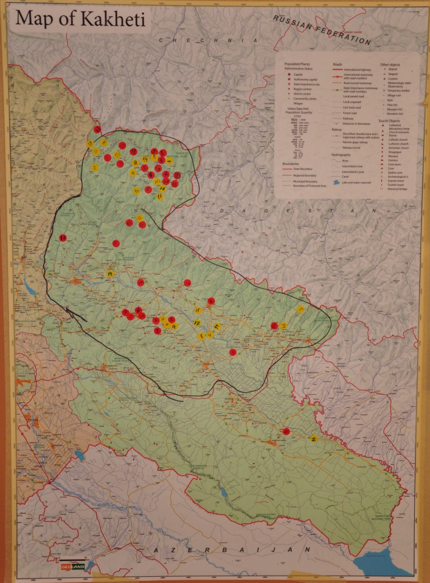
What are spatial requirements for strategy implementation?
Check if all areas demonstrating stress-/ threat-/ contributing factor cores are targeted by strategies
Considering the landscape as one complete and inter-connected unit is the key to MARISCO principles
→ Strategies must target specific key areas of the ecosystem
?
?
© Christoph Nowicki 2014
Notes:
Pictures: Prof. Dr. Pierre Ibisch

Slide 9
What is the revision of management scope and vision?
Reconsideration of manage-ment scope and vision which was set before the situation analysis
Modifications may be made according to new develop-ments (elements/ aspects/ strategies)
?

Slide 10
Why do we check consistency and plausibility of strategies?
Disparities resulting in ineffective or counterproductive management between strategies can be avoided
E.g., one strategy may set aside an area as nature protected area, while another earmarks it for development to provide income to native peoples to decrease their use of natural forests
→ Reviewing the complete strategy “package” helps ensure that such inconsistencies are not overlooked
Check can save time, money, manpower and frustration
Can also prevent further damage to the designated area
By checking to ensure sufficient availability of resources beforehand, half-implemented strategies can be avoided

Slide 11
Why do we check spatial requirements for strategy implementation?
Conservation efforts aim to target areas of greatest change and human disturbance
→ Useful to cross-check that the physical location of the strategies coincides with the identified stresses and threats in the landscape
Considering normal spatial and temporal changes in the ecosystem assures avoiding of counterproductive strategies
→ E.g., strategies struggling to reverse natural processes (annual/ seasonal flooding or burning)
Spatially well-planned landscapes can provide higher agricultural yields; higher pollination rates as compared to unplanned areas of the same size; can help decrease the spread of vector-born diseases (Check out: NATURE)
Large, interconnected areas with minimal fragmentation or habitat loss (esp. in sensitive areas) is crucial to successful strategies

Slide 12
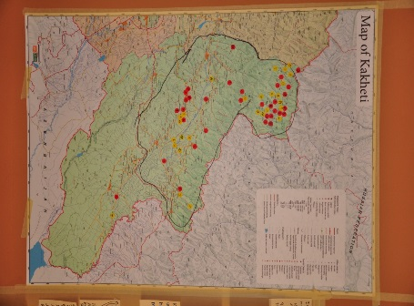
Why do we revise the scope and vision of the area?
After detailed situation analysis, it is possible the initial management focus or the assumptions for the planning project have changed
Initial scope of management and vision for the area may not be consistent with the new findings of the workgroup and planned strategies
Certain strategies might include factors lying outside the scope or extend/change the vision set before the situation analysis
→ Management scope and vision should be aligned with the strategy portfolio
?
?

Slide 13
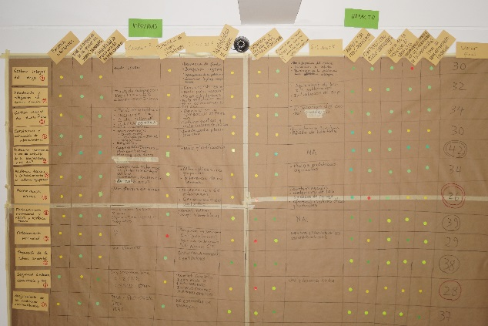
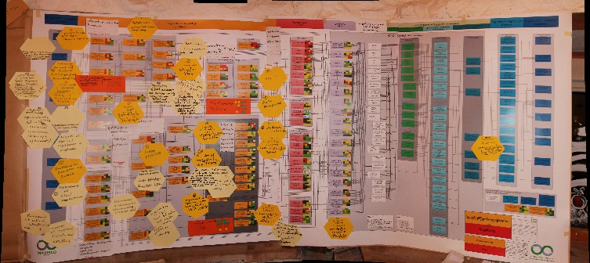
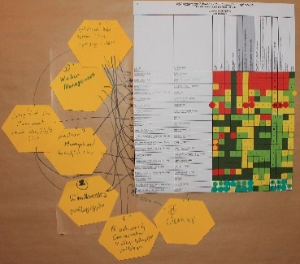
How do we check consistency and plausibility of strategies?
Obtain most updated versions of the conceptual model; ranked stresses, threats and contributing factors; lists of existing and complementary strategies; results of strategy evaluations
Ensure that there is a strategy for all relevant elements or element groups in the model
Document and complete all linkages and interactions between strategies and elements and between strategies themselves
Identify gaps that might have been overlooked during the process
Adjust strategies or elements as necessary
+
+
© Christina Lehmann 2015
© Christina Lehmann 2015
© Pierre Ibisch 2014

Slide 14
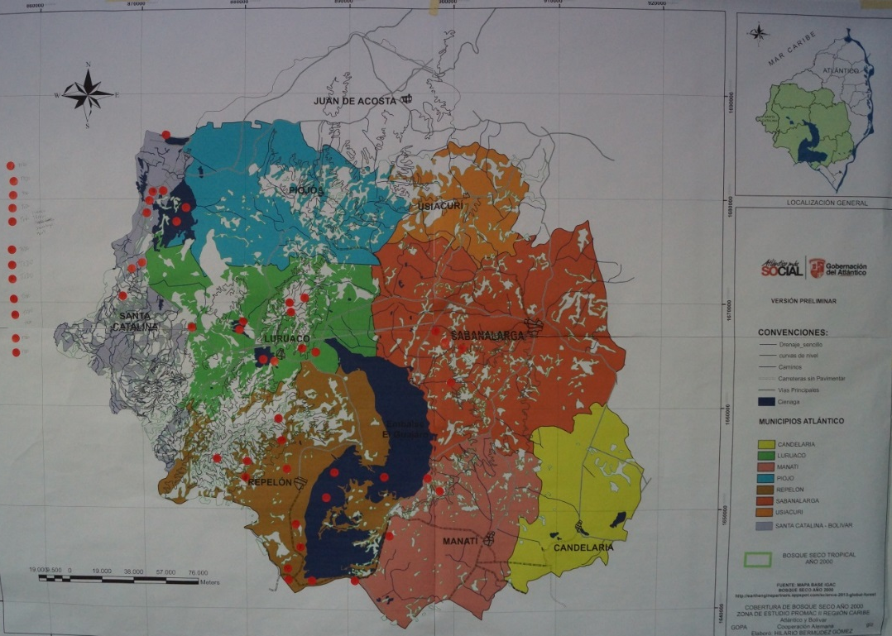
How do we check spatial requirements for strategy implementation?
Consult map created in Step 9, including the spatial analysis of biodiversity objects, threats and stresses
Red dots indicate location of identified threats and stresses
Useful at this point in time: consider where potential future risks could occur
© Pierre Ibisch 2014

Slide 15
How do we check spatial requirements for strategy implementation?
Transfer information on existing, adjusted and complementary strategies onto map, using the same color-coding as previously
What areas must be protected or improved if good functionality can be achieved?
© Pierre Ibisch 2014

Slide 16
How do we revise the scope and vision of the area?
Return to the initial ‘scope of management’ produced in Step 1 and the management vision, produced in Step 4
© Pierre Ibisch 2014
© Pierre Ibisch 2014

Slide 17
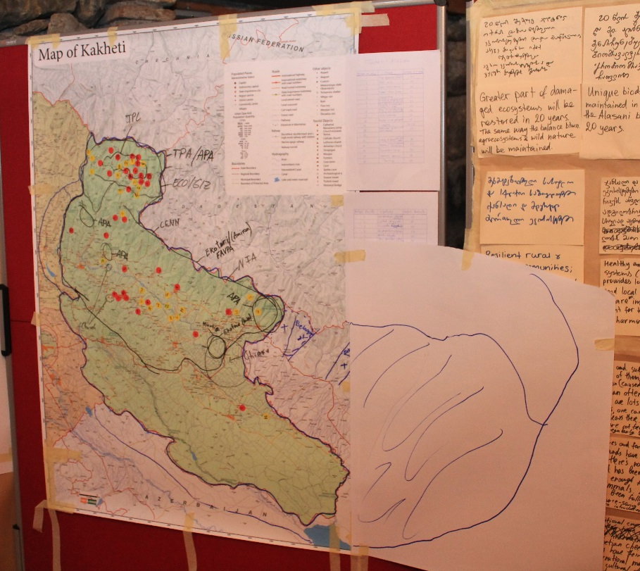
How do we revise the scope and vision of the area?
Reflect on spatial needs for each strategy and current limits of the scope
Useful guiding questions:
Does the projected management scope include all the areas that are essential for the strategies to be imple-mented on site?
If not, is it reasonable and possible to enlarge the scope?
© Christina Lehmann 2015
If scope is altered, draw the new limits on the existing map

Slide 18
How do we revise the scope and vision of the area?
With regards to the vision statement, begin discussing whether the planning team still feels that it is realistic (in the light of the information revealed in the analysis)
Consider institutional aspects, current and future vulnerabilities, spatial criteria
Discuss whether fine tuning (e.g. altering aspects of the vision) is appropriate
Do not hesitate to alter the general orientation of the management plan if appropriate
→ MARISCO is an adaptive methodology!

Slide 19
Practical Tips

