Slide 1
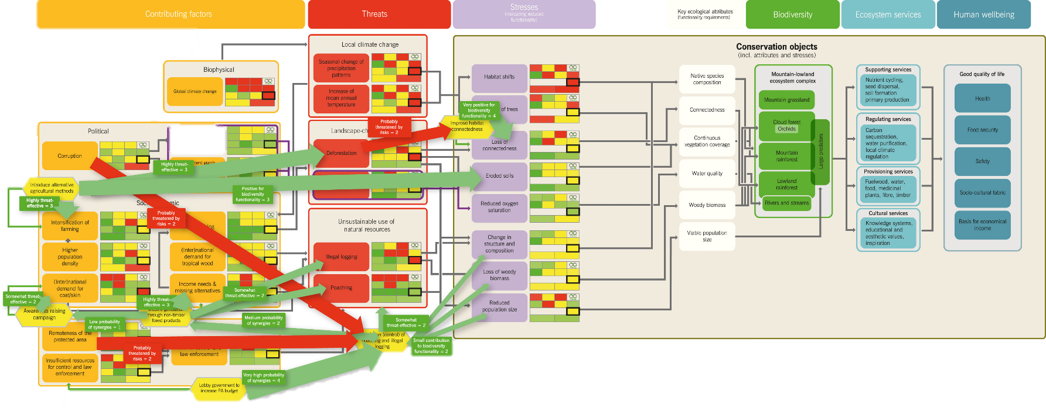
Visualisation of systemic relationships
© CEEM 2014
Phase III
Comprehensive evaluation, prioritization and strategy formulation
Steps 19 and 22

Slide 2
Credits and conditions of use
© Centre for Econics and Ecosystem Management, 2014
The Centre for Econics and Ecosystem Management strongly recommends that this presentation is given by experts familiar with the adaptive management process in general (especially as designed as the Conservation Measures Partnership’s Open Standards for the Practice of Conservation) as well as the MARISCO Method itself.
You are free to share this presentation and adapt it for your use under the following conditions:
You must attribute the work in the manner specified by the authors (but
not in any way that suggests that they endorse you or your use of the work).
You may not use this work for commercial purposes.
If you alter, transform, or build upon this work, you must remove the Centre for
Econics and Ecosystem Management logo, and you may distribute the resulting work
only under the same or similar conditions to this one.
This material was created under the leadership and responsibility of Prof. Dr. Pierre Ibisch and Dr. Peter Hobson, co-directors of the Centre for Econics and Ecosystem Management, which was jointly established by Eberswalde University for Sustainable Development and Writtle College. Compare: Ibisch, P.L. & P.R. Hobson (eds.) (2014): The MARISCO method: Adaptive MAnagement of vulnerability and RISk at COnservation sites. A guidebook for risk-robust, adaptive, and ecosystem-based conservation of biodiversity. Centre for Econics and Ecosystem Management, Eberswalde (ISBN 978-3-00-043244-6). 195 pp. - The Powerpoint Presentation was conceived by Jamie Call, Christina Lehmann and Pierre Ibisch. Authors of graphs and photographs are indicated on the corresponding slides. Supported by the Deutsche Gesellschaft für Internationale Zusammenarbeit (GIZ) GmbH on behalf of the Bundesministerium für wirtschaftliche Zusammenarbeit und Entwicklung (BMZ).

Slide 4
Learning objectives
Participants have the understanding and are able to explain that the visual analysis is an important complementing part to the strategic evaluation process as it makes obvious the actual or potential relationship of the strategies with other elements in the conceptual model.
Thus it provides a deeper understanding of the complex environments in which strategies are to be implemented and may even lead to the identification of previously overlooked risks related to the feasibility or potential impact of the strategy.
Participants are furthermore able to facilitate the process of visual evaluation of strategies.

Slide 5
Outline
What is the visualisation of systemic relationships between the elements of the conceptual model?
Why do we visualize systemic relationships between the elements?
How do we visualize systemic relationships between the elements?
Practical Tips

Slide 6
What is the visualisation of systemic relationships between elements of the conceptual model?
The depiction of existing systemic connections between the strategies already implemented and the elements identified in the conceptual model
Systemic relationships are the actual or potential interactions of the existing strategies with other elements
This encompasses both positive and negative interactions between strategies, stresses, threats, contributing factors, and biodiversity objects
Existing strategies
Stresses
Threats
Contributing factors
Biodiversity objects

Slide 7
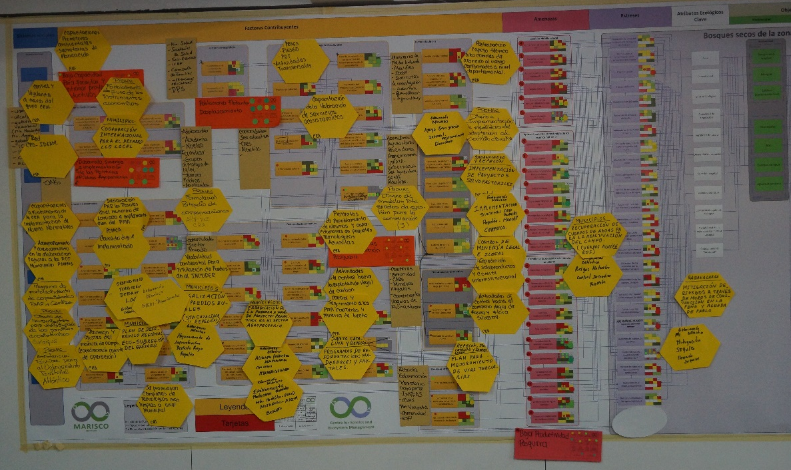
Why visualize systemic relationships?
Understanding impacting relationships between the different elements of the model aids in comprehending the complex environment where strategies will be implemented
Highlighting of interactions between elements which can cause unexpected consequences (either positive or negative!)
With this information, strategies which minimize risks or strengthen synergies can be developed
Why here? → Because…!
Why here? → Because…!
Why here? → Because…!
Why here? → Because…!
© Pierre Ibisch 2014

Slide 8
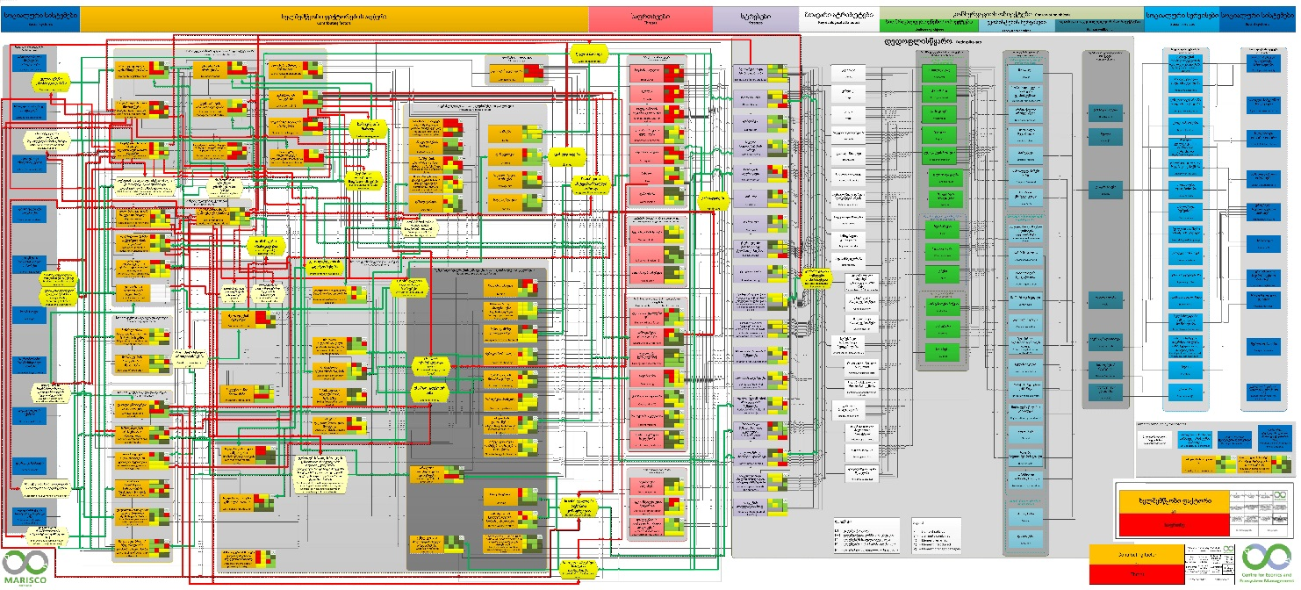
How do we visualize systemic relationships between the elements?
Best case scenario: Systemic relationships are mapped out during the workshop and then used in strategy evaluation
→ Due to time constraints, often not possible
→ In this case, this step must be followed when reconstructing the digitalized version of the conceptual model
© Christina Lehmann 2015

Slide 9
How do we visualize systemic relationships between the elements?
When this step is carried out during the workshop:
Overlay a plastic sheet on the conceptual model
OR…
© Pierre Ibisch 2012

Slide 10
How do we visualize systemic relationships between the elements?
Use a second printed version of the model
© Christina Lehmann 2015
© Christina Lehmann 2015

Slide 11
How do we visualize systemic relationships between the elements?
Start with the list of categorized existing strategies
Begin discussions by considering the impacts the strategies will directly have on stresses, threats and contributing factors as well as interactions between strategies
Existing strategies
Stresses
Existing strategies
Biodiversity objects
Further develop the logical results chain by considering the impact that strategies indirectly exert upon the biodiversity objects
Threats
Contributing factors
Steps 2-4 must be carried out by experts if the workshop did not permit it time-wise

Slide 12
How do we visualize systemic relationships between the elements?
Using the insert form options below, add arrows of appropriate color and size according to the following guidelines
Either: drawn on the plastic overlay sheet/ second model/ rankings
Or: using a computer program, such as a Visio or PowerPoint
Green arrow: Positive impact, reduction of problems
Red arrow: Negative impact, creates or increases problem
Thin arrow: Low impact
Thick arrow: Significant impact

Slide 13
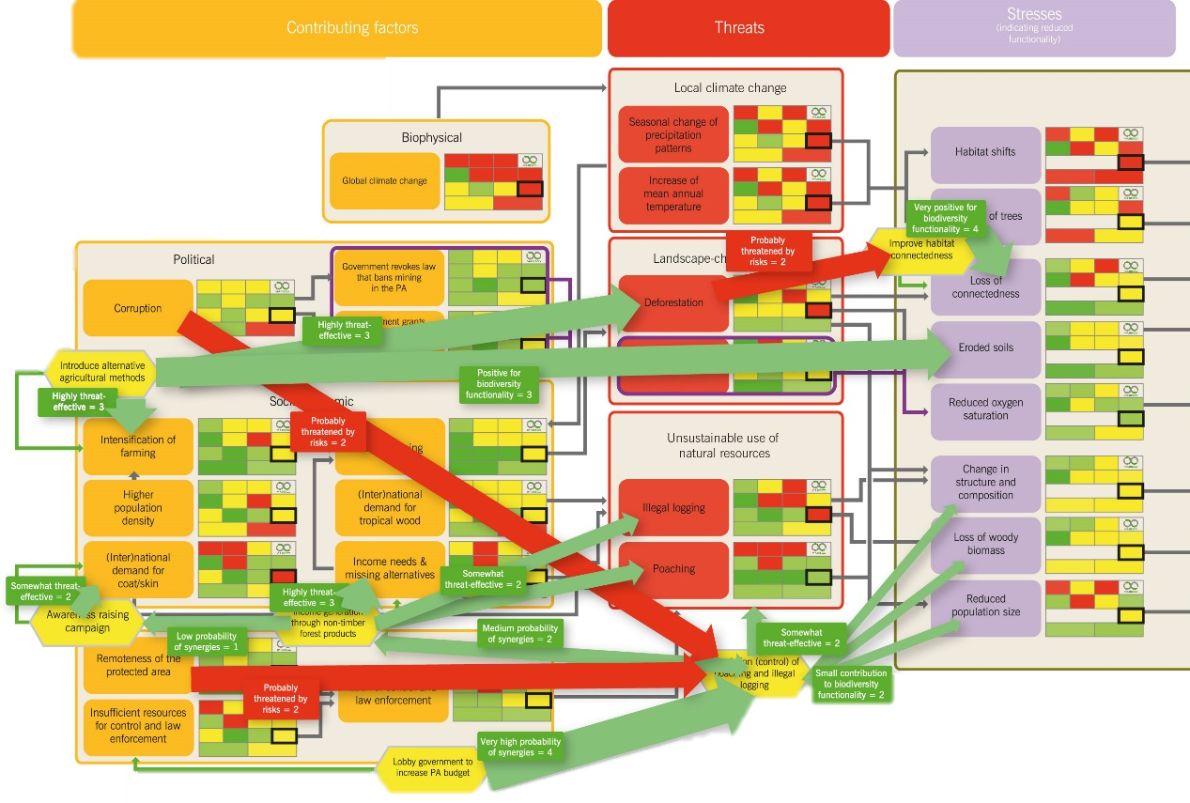
How do we visualize systemic relationships between the elements?
Possible demonstrations:
How strategies can have an effect on elements
This example depicts that the strategy “Introduce alternative agricultural methods” has a substantial positive impact on the stress “Eroded soils”

Slide 14
How do we visualize systemic relationships between the elements?
Possible demonstrations:
Ways in which elements affect strategies
E.g., a very remote protected area makes it very difficult to control poaching and illegal logging
= substantial but negative impact
Regulation (control) of poaching and illegal logging

Slide 15
How do we visualize systemic relationships between the elements?
Possible demonstrations:
Interactions between strategies can also be depicted
A double-ended green arrow of this width signals moderate synergies between these strategies
Income generation through non-timber forest products
Regulation (control) of poaching and illegal logging

Slide 16
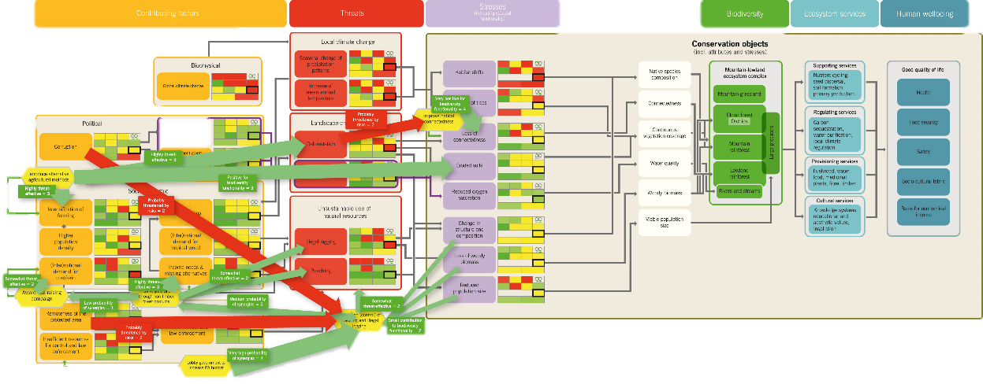
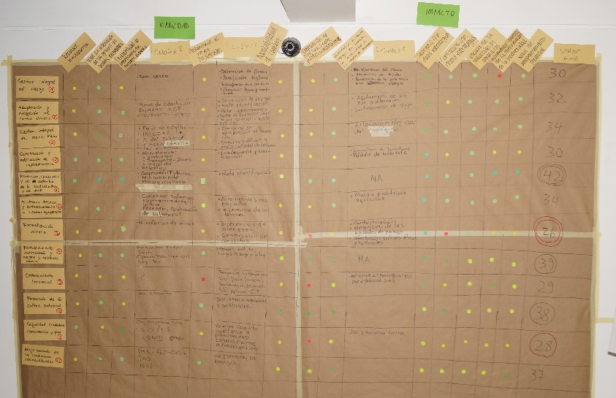
How are systemic relationships visualized?
Repeat this process for every strategy in the model
Use the insights gained from the evaluation of the relationships for the revision of the strategy evaluation
© CEEM 2014
?
© Pierre Ibisch 2014

Slide 17
Practical Tips
This step can become very extensive if focused on “too” much
→ It is supposed to exemplify possible major positive and negative interrelations which might depict which strategies to tackle in order to be improved and how
→ It also helps to rank the immediate necessity of certain strategies which should be approached first

