Slide 1
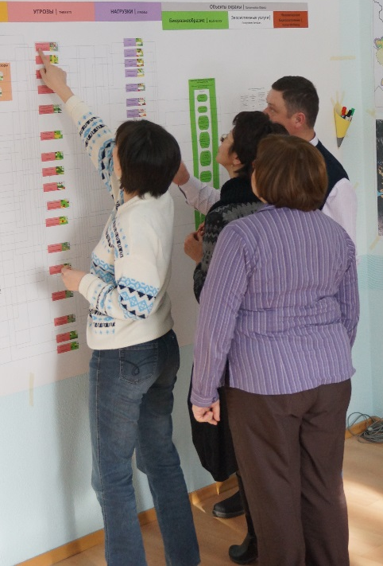
Revision and validation
© Pierre Ibisch 2014
Phase II
Systemic Vulnerability and Risk Analysis
Step 16

Slide 2
Credits and conditions of use
© Centre for Econics and Ecosystem Management, 2014
The Centre for Econics and Ecosystem Management strongly recommends that this presentation is given by experts familiar with the adaptive management process in general (especially as designed as the Conservation Measures Partnership’s Open Standards for the Practice of Conservation) as well as the MARISCO Method itself.
You are free to share this presentation and adapt it for your use under the following conditions:
You must attribute the work in the manner specified by the authors (but
not in any way that suggests that they endorse you or your use of the work).
You may not use this work for commercial purposes.
If you alter, transform, or build upon this work, you must remove the Centre for
Econics and Ecosystem Management logo, and you may distribute the resulting work
only under the same or similar conditions to this one.
This material was created under the leadership and responsibility of Prof. Dr. Pierre Ibisch and Dr. Peter Hobson, co-directors of the Centre for Econics and Ecosystem Management, which was jointly established by Eberswalde University for Sustainable Development and Writtle College. Compare: Ibisch, P.L. & P.R. Hobson (eds.) (2014): The MARISCO method: Adaptive MAnagement of vulnerability and RISk at COnservation sites. A guidebook for risk-robust, adaptive, and ecosystem-based conservation of biodiversity. Centre for Econics and Ecosystem Management, Eberswalde (ISBN 978-3-00-043244-6). 195 pp. - The Powerpoint Presentation was conceived by Jamie Call, Christina Lehmann and Pierre Ibisch. Authors of graphs and photographs are indicated on the corresponding slides. Supported by the Deutsche Gesellschaft für Internationale Zusammenarbeit (GIZ) GmbH on behalf of the Bundesministerium für wirtschaftliche Zusammenarbeit und Entwicklung (BMZ).

Slide 4
Learning objectives
Participants understand and are able to explain the relevance of revision and validation of the conceptual model with as many stakeholders and experts as possible, especially if the process lasted for longer periods, as it offers the opportunity to include further knowledge and expertise.
Participants have the skills to guide through the revision and validation process as well as to facilitate discussions about the dealing with new information that might differ from the original planning.

Slide 5
Outline
  What is revision and validation?
Why do we revise and validate the model?
How do we revise and validate the model?
  Practical Tips

Slide 6
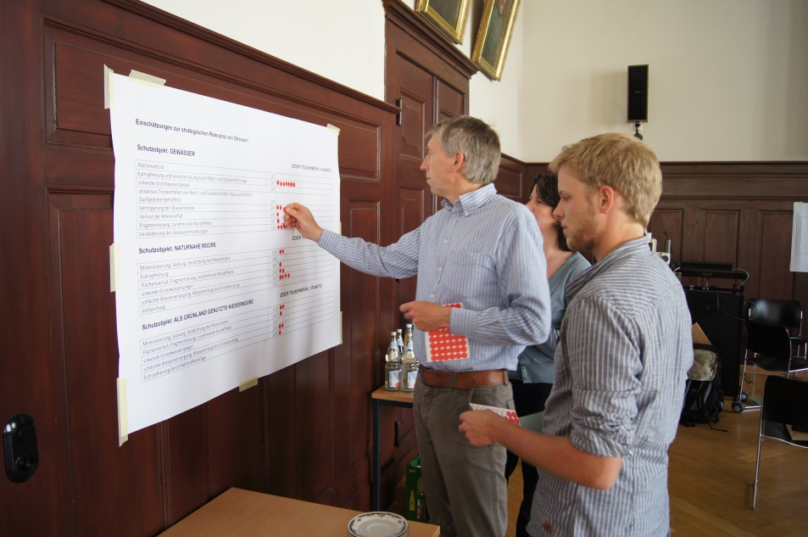
What is revision and validation?
Conducting of cross-checking the conceptual model against the knowledge and experience of people who were not involved in the initial development of the conceptual model
It is a consultation with external experts which result in inclusion of further knowledge and expertise beyond that which exists in the planning team
© Pierre Ibisch 2014
Notes:
Pictures: Prof. Dr. Pierre Ibisch

Slide 7
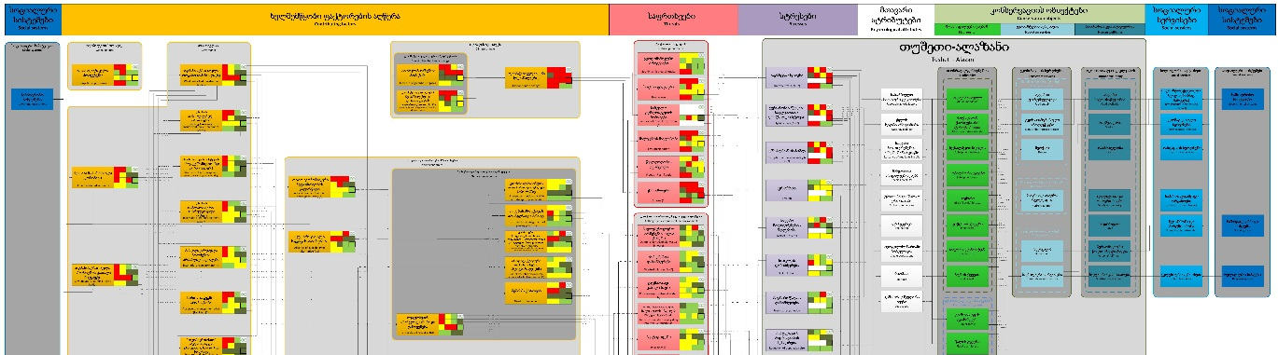
Why do we revise and validate the model?
Every review and discussion promotes a better understanding of the elements of the model that are still in question
Adding new perspectives and including further knowledge promotes critical reflection
External consultants may notice flaws or inconsistencies that those deeply involved in the planning process have missed
If the new input differs substantially from the initial input: promotion of constructive learning through discussions between the planning team and the consultees
Workshop
team:
“Experts”:
Topic D
Topic A
Topic B
Topic C
Topic A
New element

Slide 8
How do we revise and validate the model?
After completion of the model
→ ‘external’ consultants are invited to look over the model and add their input
In the form of mini-workshops or brief sessions
Experts are provided with the conceptual model (the original version, pictures or a digitalized version) and a list of the results of the strategic relevance ranking
New connections can be established, existing ones deleted; Ratings of criticality, manageability and knowledge can be changed
→ all this has to be checked with the planning team and changes cannot be made without their approval
If the results differ significantly, they can be used to stimulate a critical discussion between planning team and “experts”

Slide 9
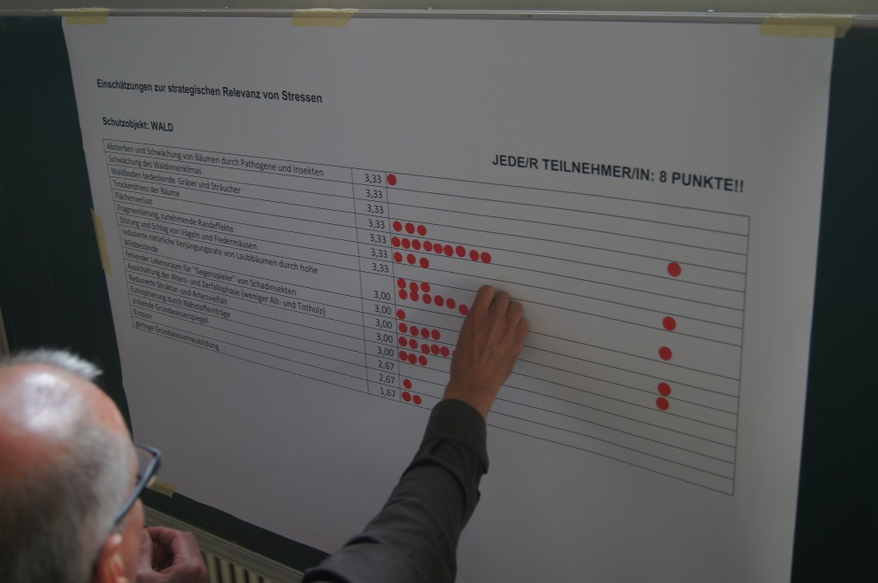
How do we revise and validate the model?
Example:
“Experts” (who had not been part of the workshop) could be asked to rate the general criticality of identified stresses, threats and contributing factors
Results can be compared to the ones from the workshop
© Pierre Ibisch 2014

Slide 10
Practical Tips
Experts should understand the chain of thoughts behind certain elements in the model and their rating
→ Therefore, coaches need to represent the workshop group and give background details on the information s/he was given by the group when certain aspects and ratings were included
Planning group should be presented the results/ offerings by the “experts” in a very encouraging, positive way which does not imply “know-all manner”
This step might cost more time than estimated
→ Let the revisers enough time or calculate buffer
→ Let them revise the MS Visio-related excel files and model in a way that results can be incorporated easily

