Slide 1
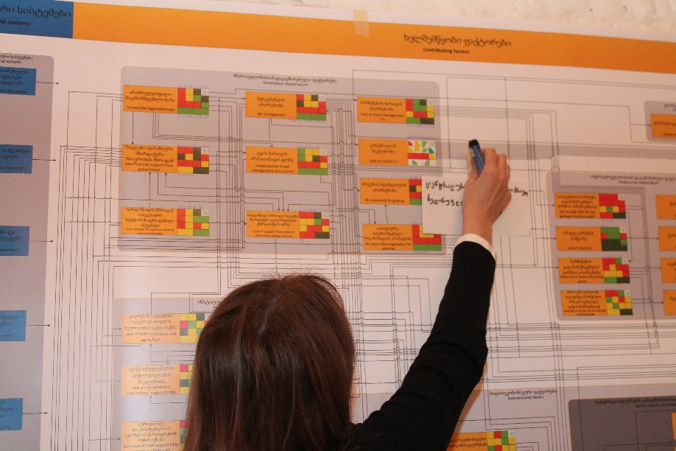
Understand the relevant actors and stakeholders
© Christina Lehmann 2015
Phase II
Systemic Vulnerability and Risk Analysis
Step 15

Slide 2
Credits and conditions of use
© Centre for Econics and Ecosystem Management, 2014
The Centre for Econics and Ecosystem Management strongly recommends that this presentation is given by experts familiar with the adaptive management process in general (especially as designed as the Conservation Measures Partnership’s Open Standards for the Practice of Conservation) as well as the MARISCO Method itself.
You are free to share this presentation and adapt it for your use under the following conditions:
You must attribute the work in the manner specified by the authors (but
not in any way that suggests that they endorse you or your use of the work).
You may not use this work for commercial purposes.
If you alter, transform, or build upon this work, you must remove the Centre for
Econics and Ecosystem Management logo, and you may distribute the resulting work
only under the same or similar conditions to this one.
This material was created under the leadership and responsibility of Prof. Dr. Pierre Ibisch and Dr. Peter Hobson, co-directors of the Centre for Econics and Ecosystem Management, which was jointly established by Eberswalde University for Sustainable Development and Writtle College. Compare: Ibisch, P.L. & P.R. Hobson (eds.) (2014): The MARISCO method: Adaptive MAnagement of vulnerability and RISk at COnservation sites. A guidebook for risk-robust, adaptive, and ecosystem-based conservation of biodiversity. Centre for Econics and Ecosystem Management, Eberswalde (ISBN 978-3-00-043244-6). 195 pp. - The Powerpoint Presentation was conceived by Jamie Call, Christina Lehmann and Pierre Ibisch. Authors of graphs and photographs are indicated on the corresponding slides. Supported by the Deutsche Gesellschaft für Internationale Zusammenarbeit (GIZ) GmbH on behalf of the Bundesministerium für wirtschaftliche Zusammenarbeit und Entwicklung (BMZ).

Slide 4
Learning objectives
Participants have a strong understanding and are able to explain the use of the step to understand relevant actors and stakeholder in order to identify actors (individuals or organisations) and their relationship to the listed contributing factors, as it possibly makes a change taking them into account when developing strategies.
Furthermore, participants have the skills to guide through the process of identifying these actors and making clear their relationship to threats and contributing factors within the conceptual model as situation analysis.

Slide 5
Table of Contents
What does understanding the relevant actors and stakeholders mean?
Why do we need to understand the relevant actors and stakeholders?
How do we understand the relevant actors and stakeholders?
Practical Tips
Notes:
Key: http://simpleicon.com/key-4.html
Lupe: http://www.spreadshirt.de/lupe-C4408A9638043
Clock: http://www.uniquecoloringpages.com/clock-coloring-pages-and-book.html
http://commons.wikimedia.org/wiki/File:Thumbs_up_font_awesome.svg

Slide 6
What does understanding the relevant actors and stakeholders mean?
Actors are individuals or organizations which are the point source of factors that contribute to the generation of threats and stresses
Identification of actors who are involved in causing a contributing factor or threat and their reasons for doing so, are significant
Adequate mapping of actors shows where the sources of problems in relation to where the sources of funding and influence are
Potential areas of overlap and conflict can be identified through actor mapping

Slide 7
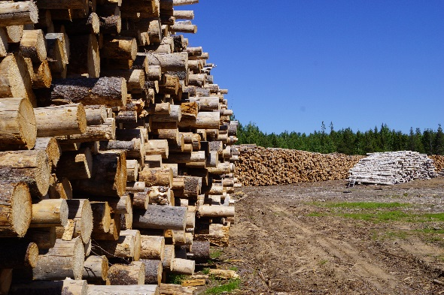
What does understanding the relevant actors and stakeholders mean?
Farmers
Small Business Owners
Firewood
Income
Small-scale farming
Game
Building materials
Plantations
Large-scale wood export
Management efforts
Conservation efforts
Construction of infrastructure
International Companies
Governments
© Pierre Ibisch 2014
Although different actors have varying motivations, they can lead to the same threats

Slide 8
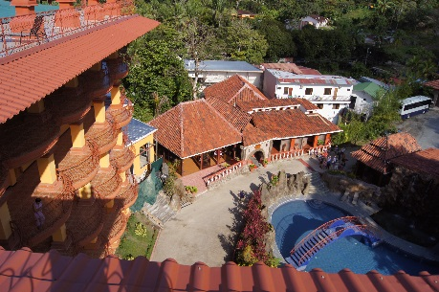
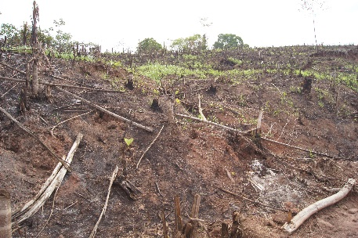
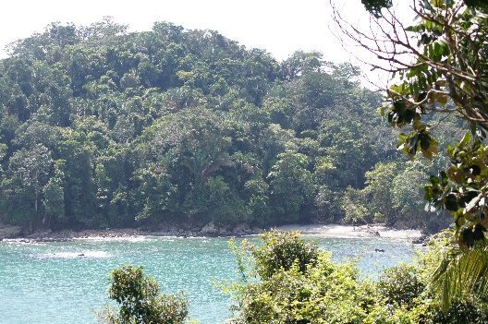
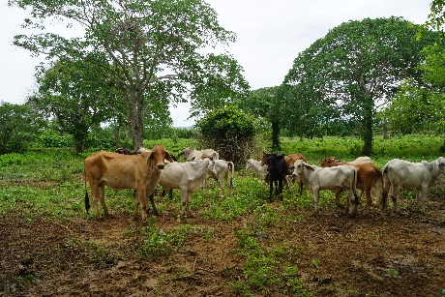
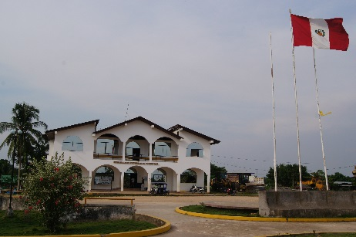
Why do we need to understand the relevant actors and stakeholders?
Ecosystem perspectives work on a large scope and try to take all relevant underlying factors in the area into account
This includes various actors and individuals who have an influence on the contributing factors, threats or stresses in the area
© Pierre Ibisch 2011
© Pierre Ibisch 2013
© Pierre Ibisch 2011
© Pierre Ibisch 2014
© Pierre Ibisch 2013

Slide 9
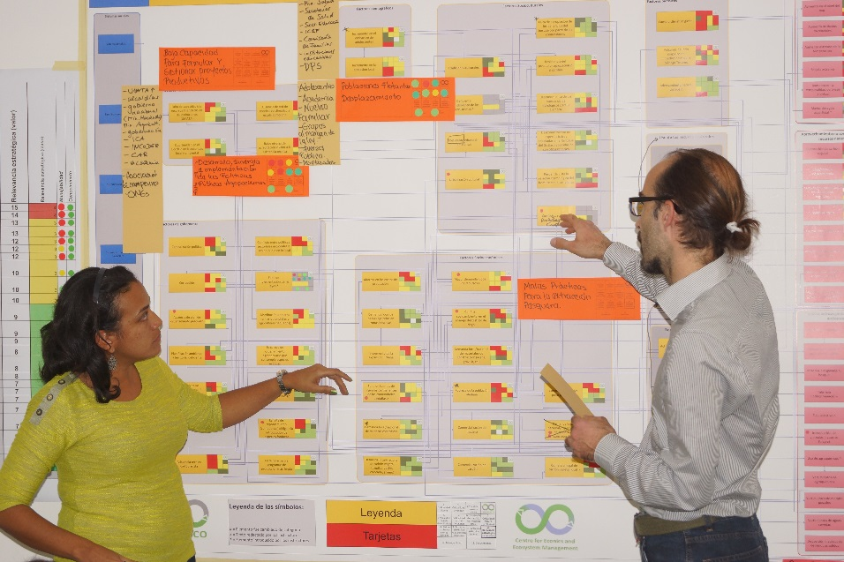
How do we understand the relevant actors and stakeholders?
Using white cards, write down the actors who influence each contributing factor or direct threat
  Sometimes, an actor will influence a whole group of contributing factors
Mapping of actors: Place the cards next to the corresponding threat, contributing factor, or group box of contributing factors
© Pierre Ibisch 2014

Slide 10
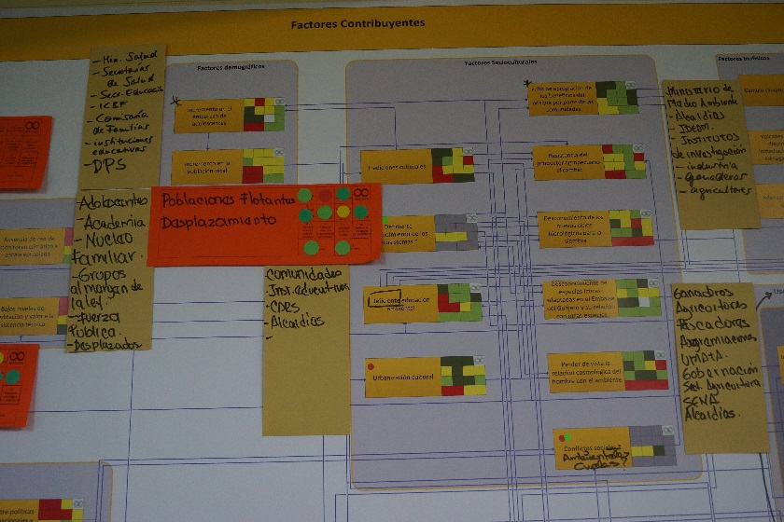
How do we understand the relevant actors and stakeholders?
Document the results in an Excel spreadsheet
During the organizational phase, institutional weaknesses will be determined (e.g. resource shortages, technical support and consulting shortages, lack of information and conflict between actors)
Actors who are related to generation of key threats in the area should be consulted and included in further planning and workshops
© Pierre Ibisch 2014

Slide 11
How do we understand the relevant actors and stakeholders?
Guiding questions:
Who is responsible for the occurrence of the factor, threat or stress?
Who has an interest in the existence or occurrence of the factor, threat or stress?
Who has an interest in the mitigation of the factor, threat or stress?

Slide 12
Practical Tips
Suggested Activity
Empathetic stakeholder perspective change
An activity where groups switch roles and consider the needs, motivations, perspectives and education of other relevant actors.
This can help remove blind spots and result in more effective strategies.
A team (part of the planning team or an extra team) follows all the steps for constructing a conceptual model.
Rather than the traditional conservation objects, elements such as roads, mines, livelihoods or plantations are inserted as the conservation objects.
The team goes through the model with their new, adopted perspective, identifying the reduced viability of these objects through threats and contributing factors.
See also: Phase II, Step 11. Develop Future Scenarios

Slide 13
Practical Tips
Take political situation and conflicts into account
→ Try to get a picture of reality regarding interrelations between for example industry, resource management and conservation
→ If the inter-exchangeability between actors is too close your conservation intention could be to much influenced
→ Take corruption into account

