Slide 1
Analysis of systemic activity and the strategic relevance of stresses, threats and contributing factors
© Axel Schick 2015
Phase II
Systemic Vulnerability and Risk Analysis
Step 13

Slide 2
Credits and conditions of use
© Centre for Econics and Ecosystem Management, 2014
The Centre for Econics and Ecosystem Management strongly recommends that this presentation is given by experts familiar with the adaptive management process in general (especially as designed as the Conservation Measures Partnership’s Open Standards for the Practice of Conservation) as well as the MARISCO Method itself.
You are free to share this presentation and adapt it for your use under the following conditions:
You must attribute the work in the manner specified by the authors (but
not in any way that suggests that they endorse you or your use of the work).
You may not use this work for commercial purposes.
If you alter, transform, or build upon this work, you must remove the Centre for
Econics and Ecosystem Management logo, and you may distribute the resulting work
only under the same or similar conditions to this one.
This material was created under the leadership and responsibility of Prof. Dr. Pierre Ibisch and Dr. Peter Hobson, co-directors of the Centre for Econics and Ecosystem Management, which was jointly established by Eberswalde University for Sustainable Development and Writtle College. Compare: Ibisch, P.L. & P.R. Hobson (eds.) (2014): The MARISCO method: Adaptive MAnagement of vulnerability and RISk at COnservation sites. A guidebook for risk-robust, adaptive, and ecosystem-based conservation of biodiversity. Centre for Econics and Ecosystem Management, Eberswalde (ISBN 978-3-00-043244-6). 195 pp. - The Powerpoint Presentation was conceived by Jamie Call, Christina Lehmann and Pierre Ibisch. Authors of graphs and photographs are indicated on the corresponding slides. Supported by the Deutsche Gesellschaft für Internationale Zusammenarbeit (GIZ) GmbH on behalf of the Bundesministerium für wirtschaftliche Zusammenarbeit und Entwicklung (BMZ).

Slide 3
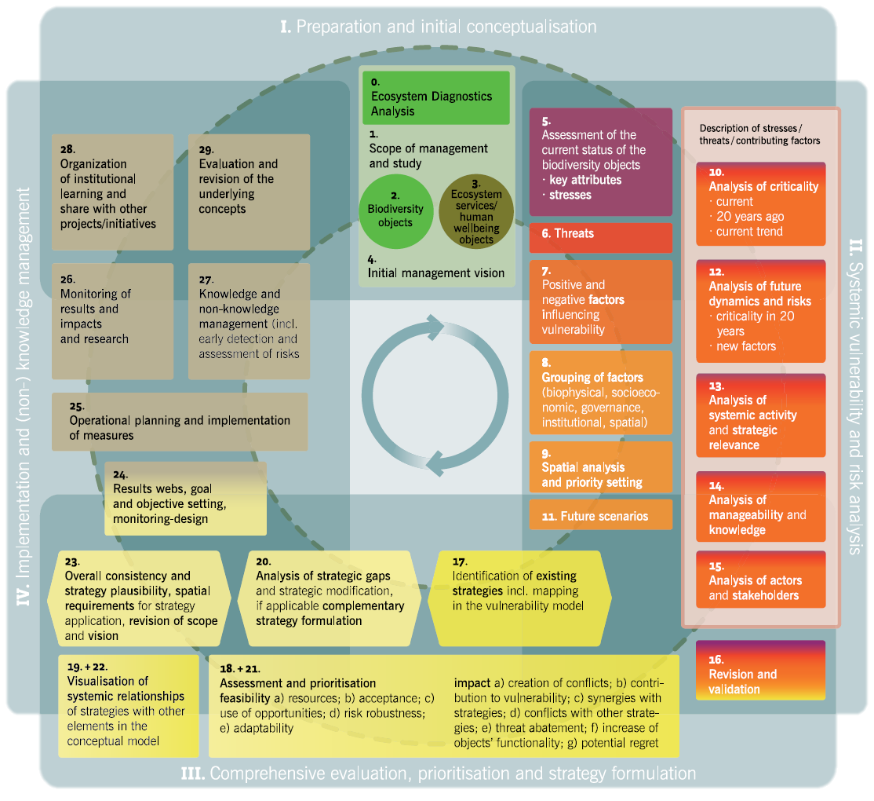

Slide 4
Learning objectives
Participants are able to explain the rationale for this step as
- the systemic activity as the level of activity of threats and factors is assessed in order to get an insight how strong is their influence on the system, and
- the strategic relevance summing up the different ratings of the previous steps is assessed to identify the most relevant elements in the conceptual model in order to serve as input for prioritising these elements, which is important when developing strategies.
Furthermore they are able to guide through a process of interpreting these results as a preparation of its implications for management strategy development.
Participants have the skills to facilitate the assessment of the systemic activity as well as to calculate the strategic relevance.

Slide 5
Outline
  What is systemic activity?
  What is strategic relevance?
Why do we analyse systemic activity and strategic relevance?
  How do we analyse systemic activity?
  How do we analyse strategic relevance?
  Practical Tips

Slide 6
What is systemic activity?
Any threat or contributing factor which is said to be systemic exerts influence on the entire ecosystem
Every threat and factor has an indirect influence and is classified based on their level of influence:
  Level of activity: This category describes whether the element is passively influenced by other elements or whether it shapes the ecosystem through its high level of influence
  Number of elements that are influenced: This category simply counts the number of elements which are affected by the element
The factors which have a high systemic activity have a higher influence on the system
Contributing factor
Threat
Stress
Contributing factor
Contributing factor
Threat
Stress
Notes:
Pictures: Prof. Dr. Pierre Ibisch

Slide 7
What is strategic relevance?
A summary of the outcomes of different ratings undertaken in previous steps
It includes the current criticality, current trend of criticality, future criticality, systemic activity
It helps to identify the most relevant elements in the system
To be tackled via strategy
Contributing factor
Threat
Stress
Contributing factor
Contributing factor
Threat
Stress
Notes:
Pictures: Prof. Dr. Pierre Ibisch

Slide 8
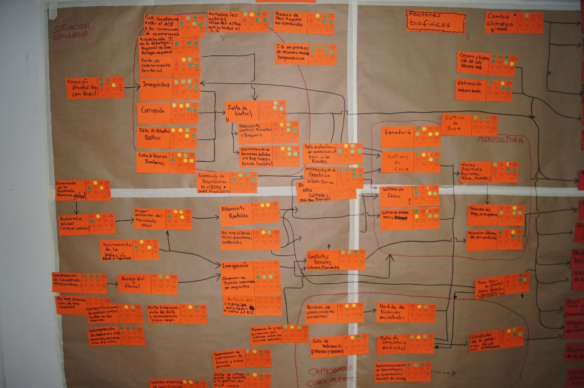
Why do we analyse systemic activity and strategic relevance?
Few, if any, threats or contributing factors act independently of one another
By developing an understanding the cause-effect relations during the situational analysis, the biggest drivers of change can be identified
These can be used as leverage points to alter problematic cause-effect chains
When resources are limited, the factors which cause the furthest reaching or most critical harms to ecosystems need to be identified and prioritized
Important to find most effective strategies
© Pierre Ibisch 2013

Slide 9
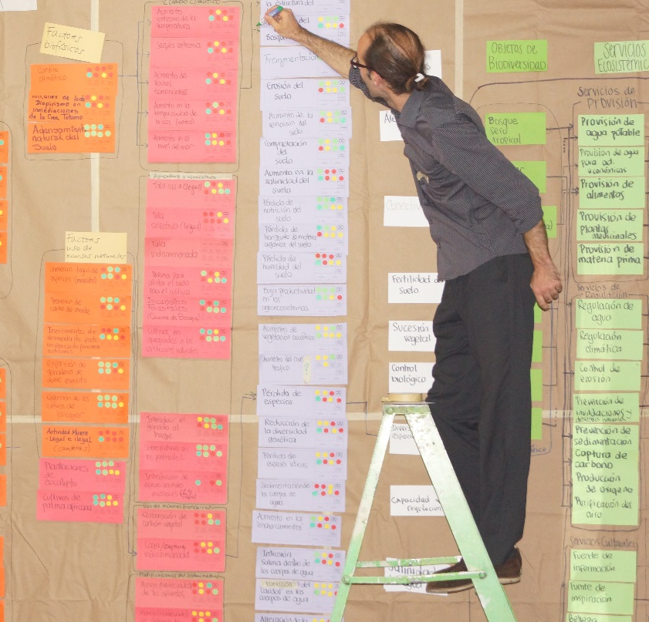
How do we analyse systemic activity?
During the process of completing the conceptual model, you will determine factors which influence or are influenced by one another
Necessity to have completed this process before analyzing systemic activity
Record the connections via a matrix in an Excel spreadsheet and count them
© Pierre Ibisch 2014

Slide 10
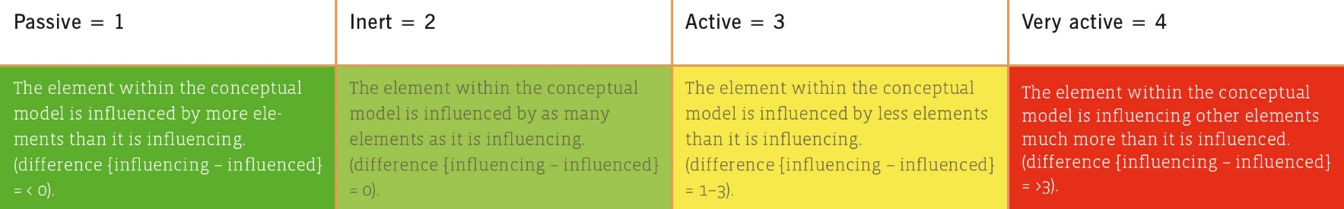
How do we analyse systemic activity?
First, the level of activity of each threat and contributing factor is calculated
To determine the level of activity of element A, the number of other elements, which element A is influenced by, will be subtracted from the number it influences
Using this number in the following table, it is possible to determine whether this is a passive, inert, active or very active element
© CEEM 2014

Slide 11
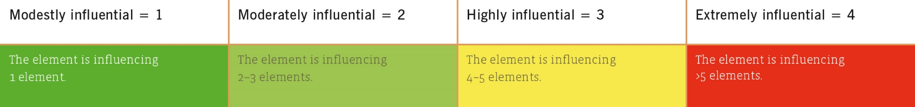
How do we analyse systemic activity?
Afterwards, the number of elements that are influenced by element A is investigated
This measures activity considering the influence that element A has upon other elements
Use the following table to determine how influential each element is
© CEEM 2014

Slide 12
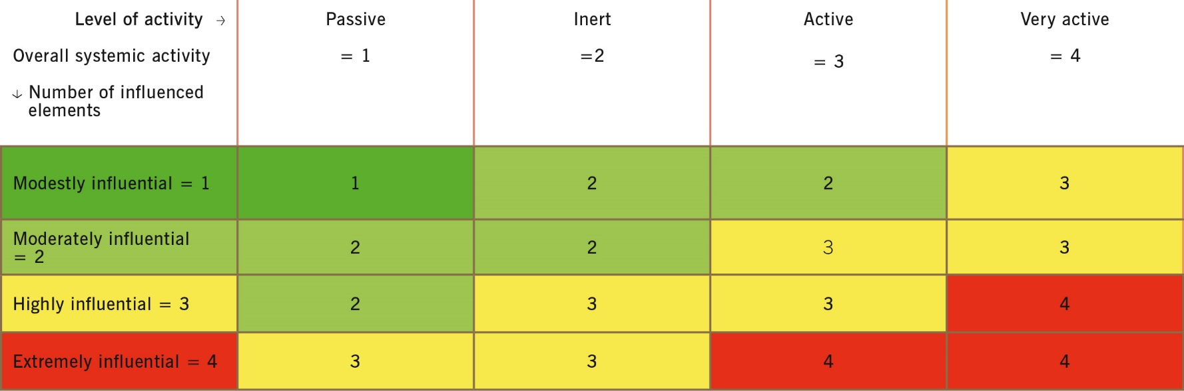
How do we analyse systemic activity?
As a first result, the overall systemic activity is calculated using the following table
  When using Excel spreadsheets use the following formula:
  =roundup(([Value from Level of Activity]+[Value from Number of Elements that are Influenced])/2)
© CEEM 2014

Slide 13
How do we analyse strategic relevance?
Finally, the strategic relevance (R) is established
  The values from the rating of elements in the conceptual model as well as the evaluation matrix are plugged into the following formula
R = CC + CT + CF + SA
CC = current criticality
CT = current trend of criticality
CF = future criticality
SA = systemic activity
  This step will ideally be carried out using Excel with the following formula:
  =sum([Value of current criticality]+[Value of trend of criticality]+[Value of future criticality]+[Value of Systemic Activity]) to arrive at the Strategic relevance (value)

Slide 14
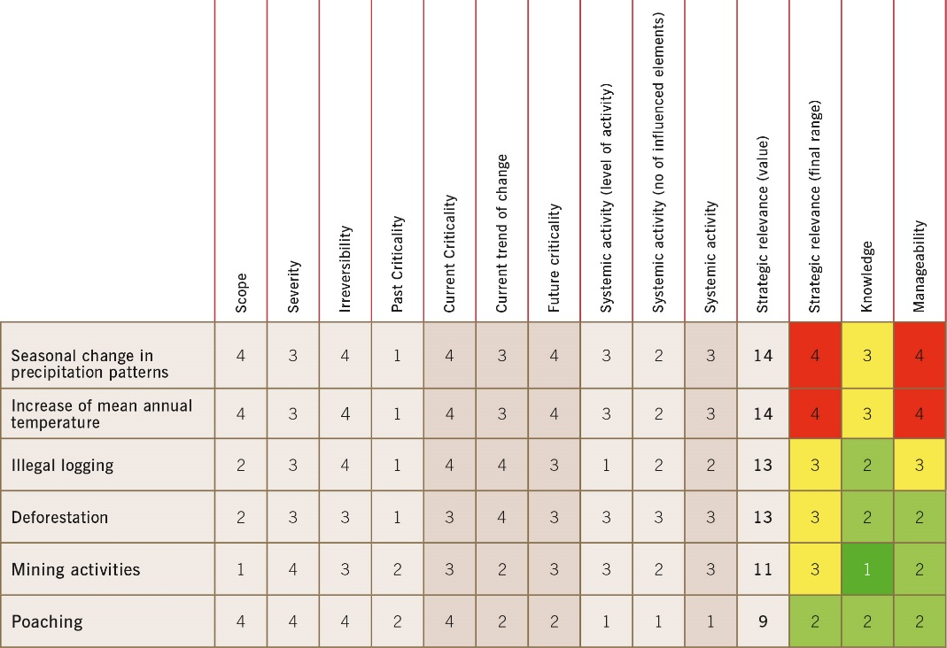
How do we analyse strategic relevance?
  To turn this value into the final range, the following conversion can be used:
  For stresses:
  11-12 = 4 [very high, red];
  9-10 = 3 [high, yellow] ;
  7- 8 = 2 [moderate, light green];
  4- 6 = 1 [low, dark green]
© CEEM 2014
  For threats & contributing factors:
  14-16 = 4 [very high, red]; 11-13 = 3 [high, yellow] ;
  8-10 = 2 [moderate, light green]; 4- 7 = 1 [low, dark green]

Slide 15
Practical Tips
It has proven helpful to colour all ratings in the table accordingly
4 = red
3 = yellow
2 = light green
1 = dark green
The significance of the single ratings of the element (current-, past-, future criticality, current trend of change etc.) become more obvious and patterns can be observed
© Axel Schick 2015

