Slide 1
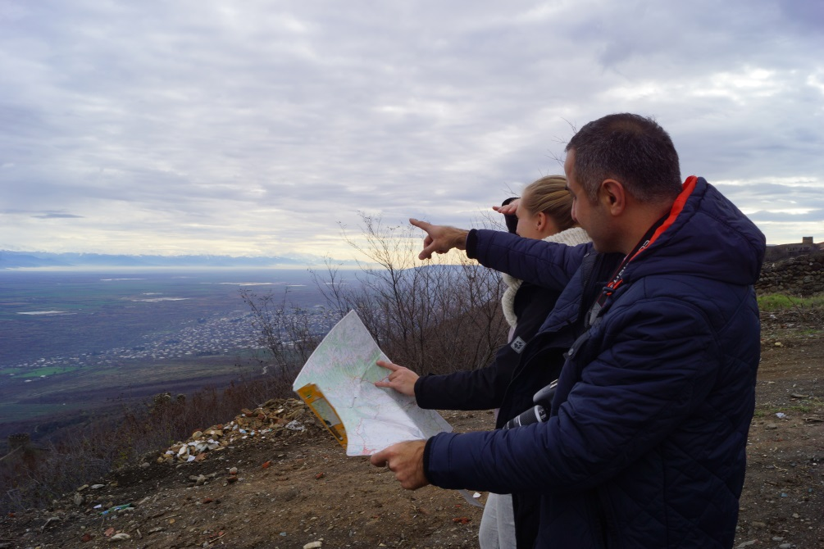
Ecosystem Diagnostics Analysis
© Pierre Ibisch 2014
Phase I
Preparation and Initial Conceptualisation
Step 0

Slide 2
Credits and conditions of use
© Centre for Econics and Ecosystem Management, 2014
The Centre for Econics and Ecosystem Management strongly recommends that this presentation is given by experts familiar with the adaptive management process in general (especially as designed as the Conservation Measures Partnership’s Open Standards for the Practice of Conservation) as well as the MARISCO Method itself.
You are free to share this presentation and adapt it for your use under the following conditions:
You must attribute the work in the manner specified by the authors (but
not in any way that suggests that they endorse you or your use of the work).
You may not use this work for commercial purposes.
If you alter, transform, or build upon this work, you must remove the Centre for
Econics and Ecosystem Management logo, and you may distribute the resulting work
only under the same or similar conditions to this one.
This material was created under the leadership and responsibility of Prof. Dr. Pierre Ibisch and Dr. Peter Hobson, co-directors of the Centre for Econics and Ecosystem Management, which was jointly established by Eberswalde University for Sustainable Development and Writtle College. Compare: Ibisch, P.L. & P.R. Hobson (eds.) (2014): The MARISCO method: Adaptive MAnagement of vulnerability and RISk at COnservation sites. A guidebook for risk-robust, adaptive, and ecosystem-based conservation of biodiversity. Centre for Econics and Ecosystem Management, Eberswalde (ISBN 978-3-00-043244-6). 195 pp. - The Powerpoint Presentation was conceived by Jamie Call, Christina Lehmann and Pierre Ibisch. Authors of graphs and photographs are indicated on the corresponding slides. Supported by the Deutsche Gesellschaft für Internationale Zusammenarbeit (GIZ) GmbH on behalf of the Bundesministerium für wirtschaftliche Zusammenarbeit und Entwicklung (BMZ).

Slide 3
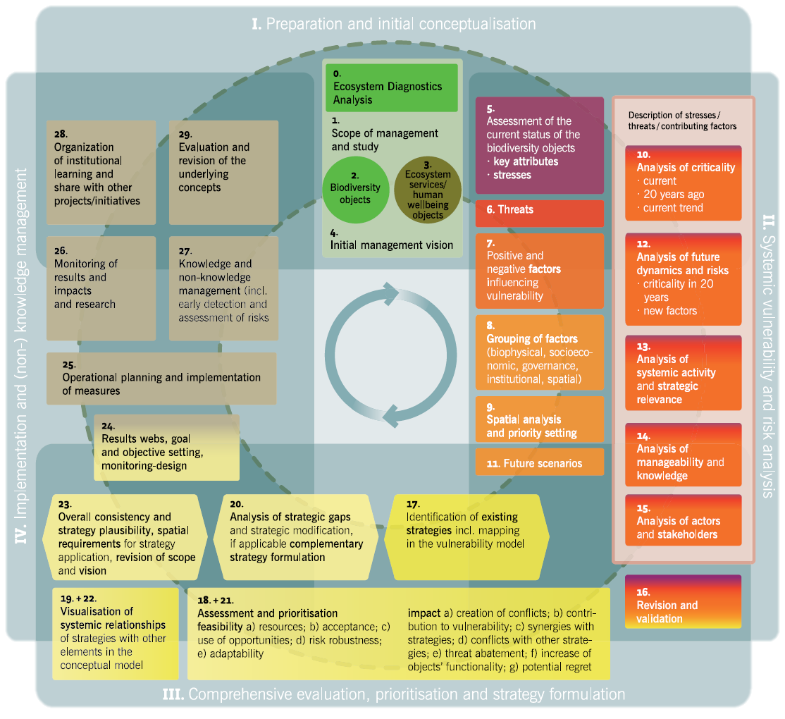

Slide 4
Learning objectives
Participants have specific knowledge of the ecosystem diagnostics analysis (EDA) as a process of holistic investigation of a landscape characterising and evaluating land use change with direct relevance to the conservation interests of the area.
By providing a large-scale perspective it enables the practitioner to view a project site in a wider context.
Participants are able to explain the rationale behind the EDA to provide an intuitive understanding of the specific ecosystem, its elements and ongoing processes and their functionality in order to get a better overview on the landscape and support the delineation of boundaries for a MARISCO analysis.
Participants are able to guide a team through the different steps of the EDA process (satellite images, desktop study, generation of further questions, field study and analysis of evidence).
They can show different useful functions of google-earth (like zoom, time slider, historical imagery, ruler) for the satellite image exercise.

Slide 5
Outline
What is an Ecosystem Diagnostics Analysis?
Why do we perform an Ecosystem Diagnostics Analysis?
How do we perform an Ecosystem Diagnostics Analysis?
Practical Tips

Slide 6
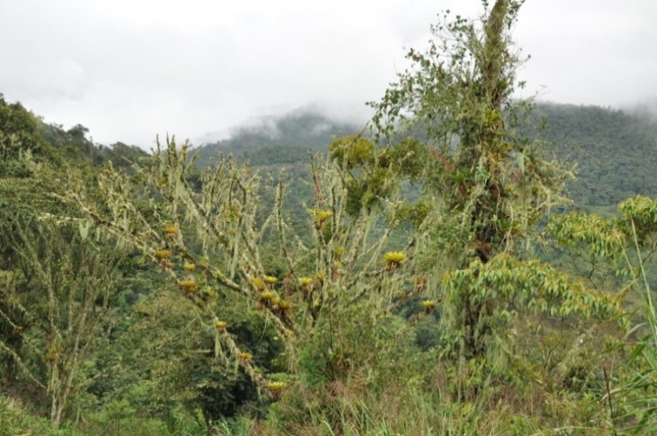
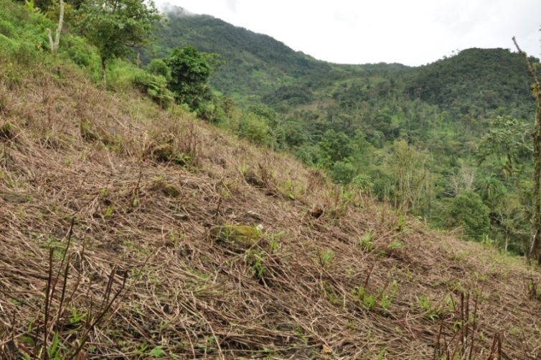
What is an Ecosystem Diagnostics Analysis?
Holistic investigation of the landscape
Large-scale perspective that enables the practitioner to view a project site in a wider context
Process of characterising and evaluating land use change with direct relevance to the conservation interests of the area
It helps us to understand how and why such radical changes in land use occur
© Pierre Ibisch 2014
© Pierre Ibisch 2014
Notes:
Pictures: Prof. Dr. Pierre Ibisch

Slide 7
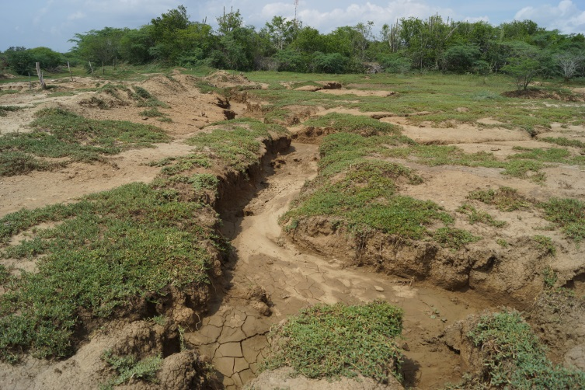
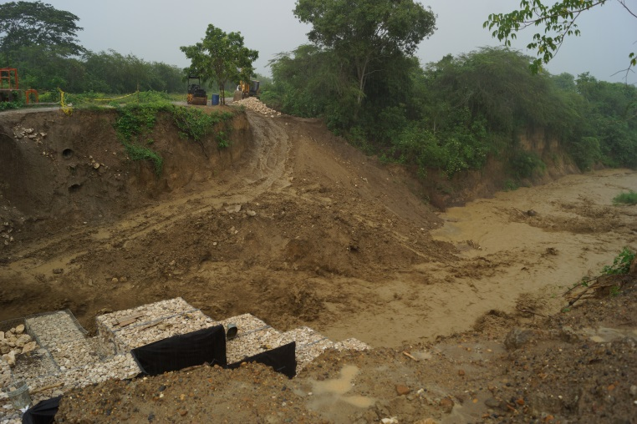
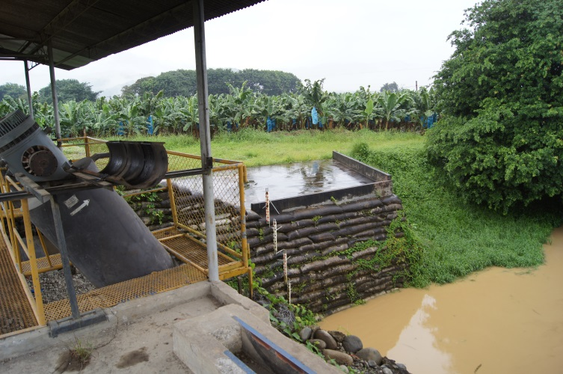
What is an Ecosystem Diagnostics Analysis?
Natural and human induced changes produce direct and indirect effects
Due to the complex nature of ecosystems, they often interact to create feedback loops
© Pierre Ibisch 2014
© Pierre Ibisch 2014
© Pierre Ibisch 2014
Notes:
Pictures: Prof. Dr. Pierre Ibisch

Slide 8
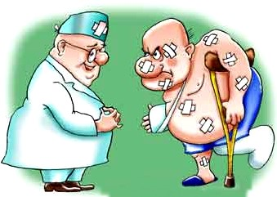
What is an Ecosystem Diagnostics Analysis?
Could be seen as a diagnostics exercise carried out by medical doctors
→ interpretation of patient’s symptoms in the light of background information gathered through inquiring his past life (habits, diseases, general health, living conditions)
= snap shot of the patient’s current
situation
Understanding weaknesses and
vulnerability for appropriate treatment
© Microsoft
either…
Notes:
Pictures: Prof. Dr. Pierre Ibisch

Slide 9
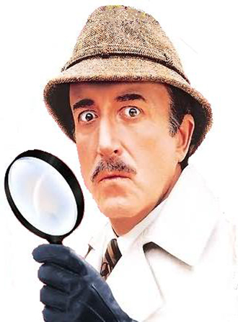
What is an Ecosystem Diagnostics Analysis?
Could be compared to the work of a criminalist
→ detecting severe problems and damages to reconstruct complex pathways that generate the deed/ crime (attacks against the functionality of ecological systems and the depending human wellbeing)
Any signs or indicators have to be used intelligently for hypothesis formulation that can be validated or falsified
Ideally, the responsible agent is identified and can be stopped through strategic treatment
…or
© Microsoft
Notes:
Pictures: Prof. Dr. Pierre Ibisch

Slide 10
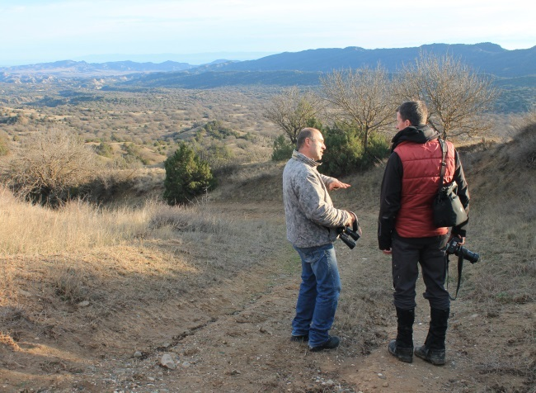
Why do we perform an Ecosystem Diagnostics Analysis?
It provides intuitive understanding of the specific ecosystem, its elements and ongoing processes and their functionality
Forces of change to an ecosystem are well observable
Gives a better overview on the landscape and supports the delineation of boundaries for a MARISCO analysis (increasing the extent of coverage) – potential threats may become visible; at the expense of losing ecological detail at the local scale
It is robust and appropriate when the studied area has a variety of land cover types, from natural to modified
It is a resource-efficient tool that can be conducted with a limited budget, equipment, research and knowledge
Good option for experts to get a first hand-impression on the region(s) studied
© Christina Lehmann 2014

Slide 11
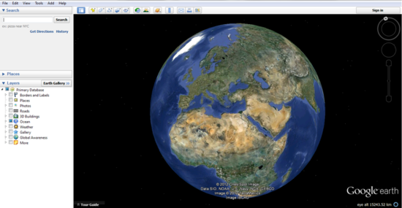
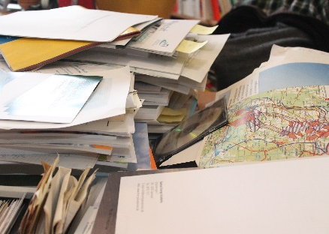

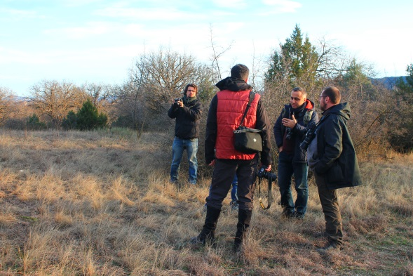
How do we perform an Ecosystem Diagnostics Analysis?
Why?
How?
Who?
When?
© Google earth
© Christina Lehmann 2015
Google Earth Images
Desktop Study
Generation of further questions
© Christina Lehmann 2014
Analysis of evidence
Field study
Notes:
Pictures to be replaced!

Slide 12
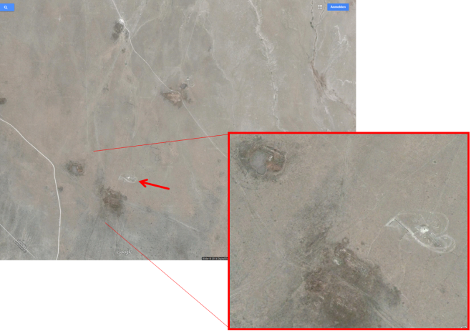
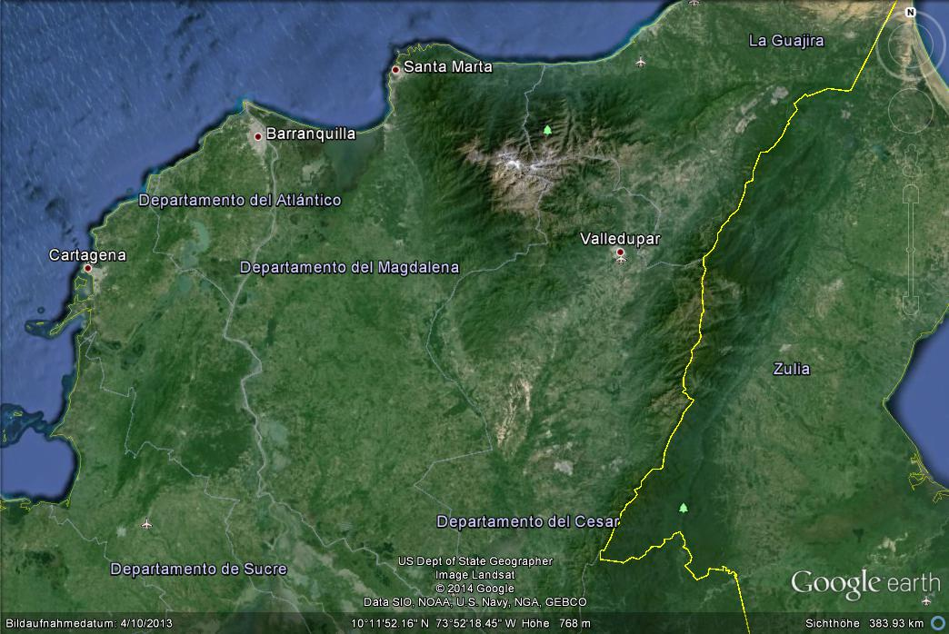
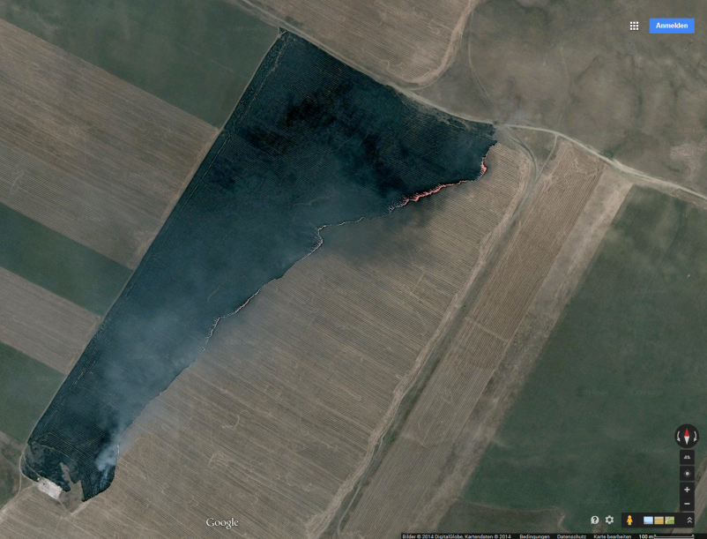
Phase I –
Google Earth & Desktop study
© Google earth
© Google earth
© Google earth
© Google earth
Notes:
Pictures: Google earth

Slide 13
How to:
Use Google Earth Images
Examination of (satellite) pictures of the project site at several resolutions
© Google earth
If sophisticated programs like Geographic Infor-mation Systems (GIS) are not available, Google Earth is an appropriate option
© Google earth
Notes:
Pictures: Google earth

Slide 14
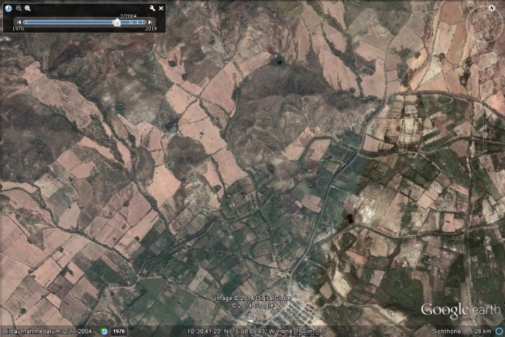
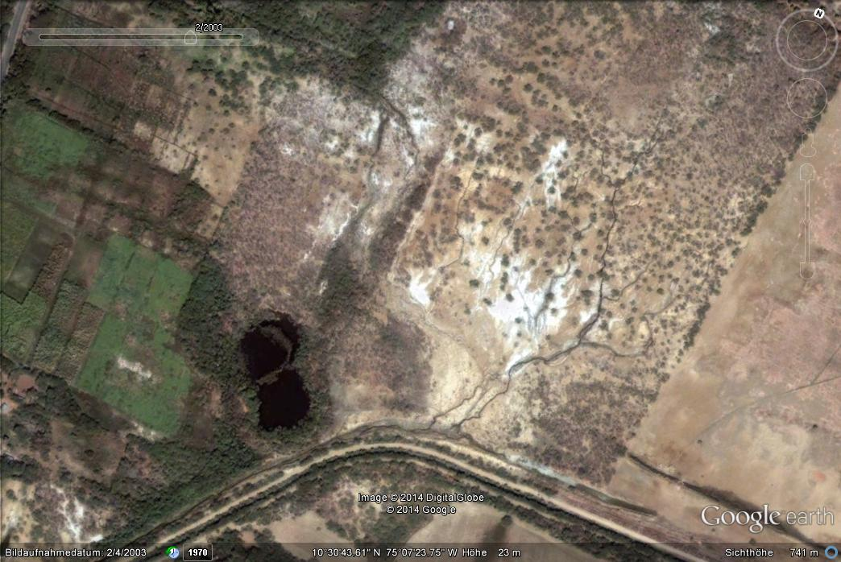

How to:
Use Google Earth Images
Examination of the pictures at different scales
Closer look at areas of interest
© Google earth
Notes:
Pictures: Google earth

Slide 15
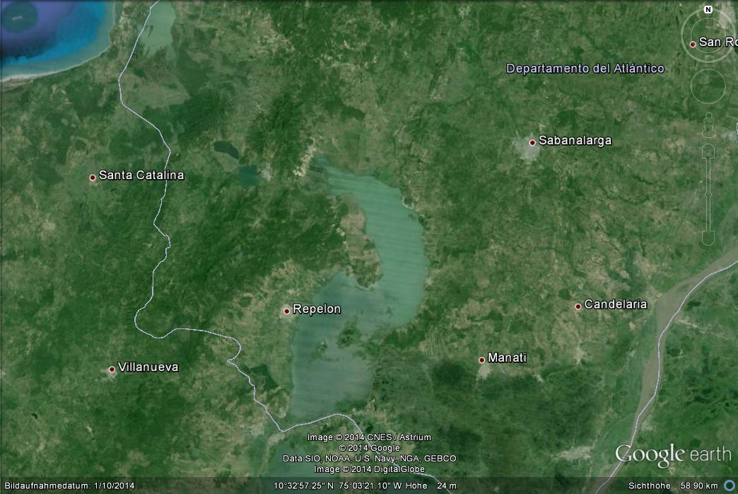
How to:
Use Google Earth Images
Identification of “key stone ecosystems” and land use
  Location, relief, vegetation, water bodies, wetlands etc.
  Agricultural lands, infrastructure, dams, urban areas etc.
© Google earth
Notes:
Pictures: Google earth

Slide 16

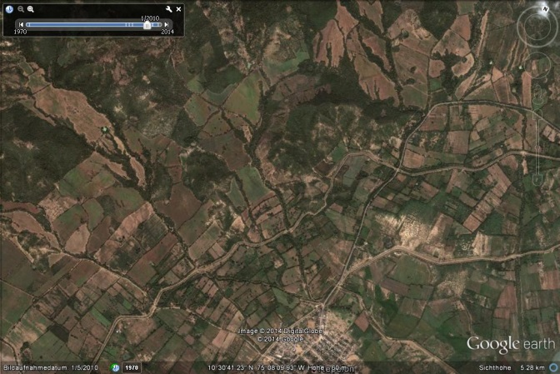
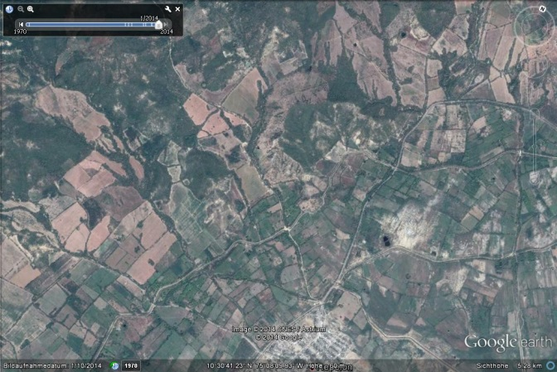
How to:
Use Google Earth Images
Usage of historical imagery
  Land use changes and potential threats can be identified and further examined
  Signs of river engineering, mining, boundary alteration, patches on the landscape etc. should be investigated
…2010…
…2014…
© Google earth

Slide 17
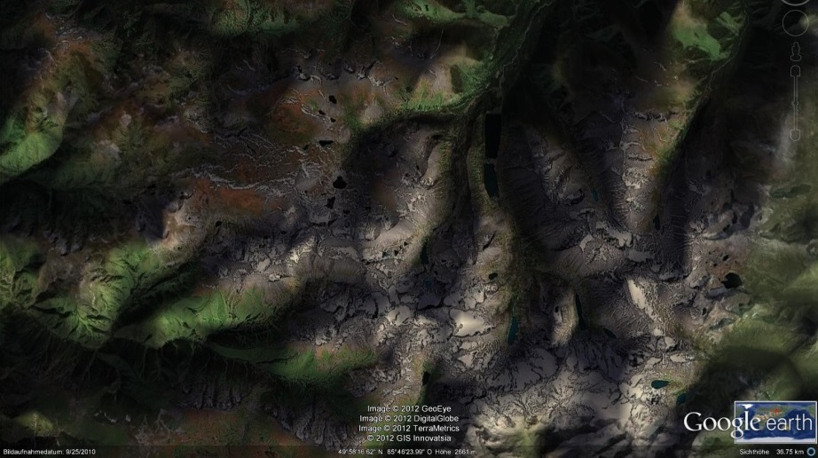
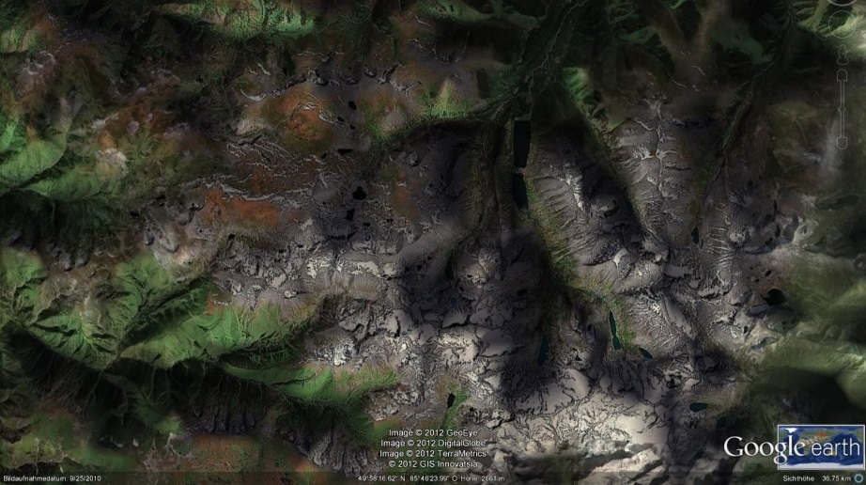
How to:
Use Google Earth Images
  Using the “time slider” function to better understand landform relief and the influence of topography on vegetation patterns (shading, exposition etc.)
This example depicts the morning situation in the Altai Mountains
© Google earth
This example depicts the afternoon situation in the Altai Mountains
© Google earth

Slide 18
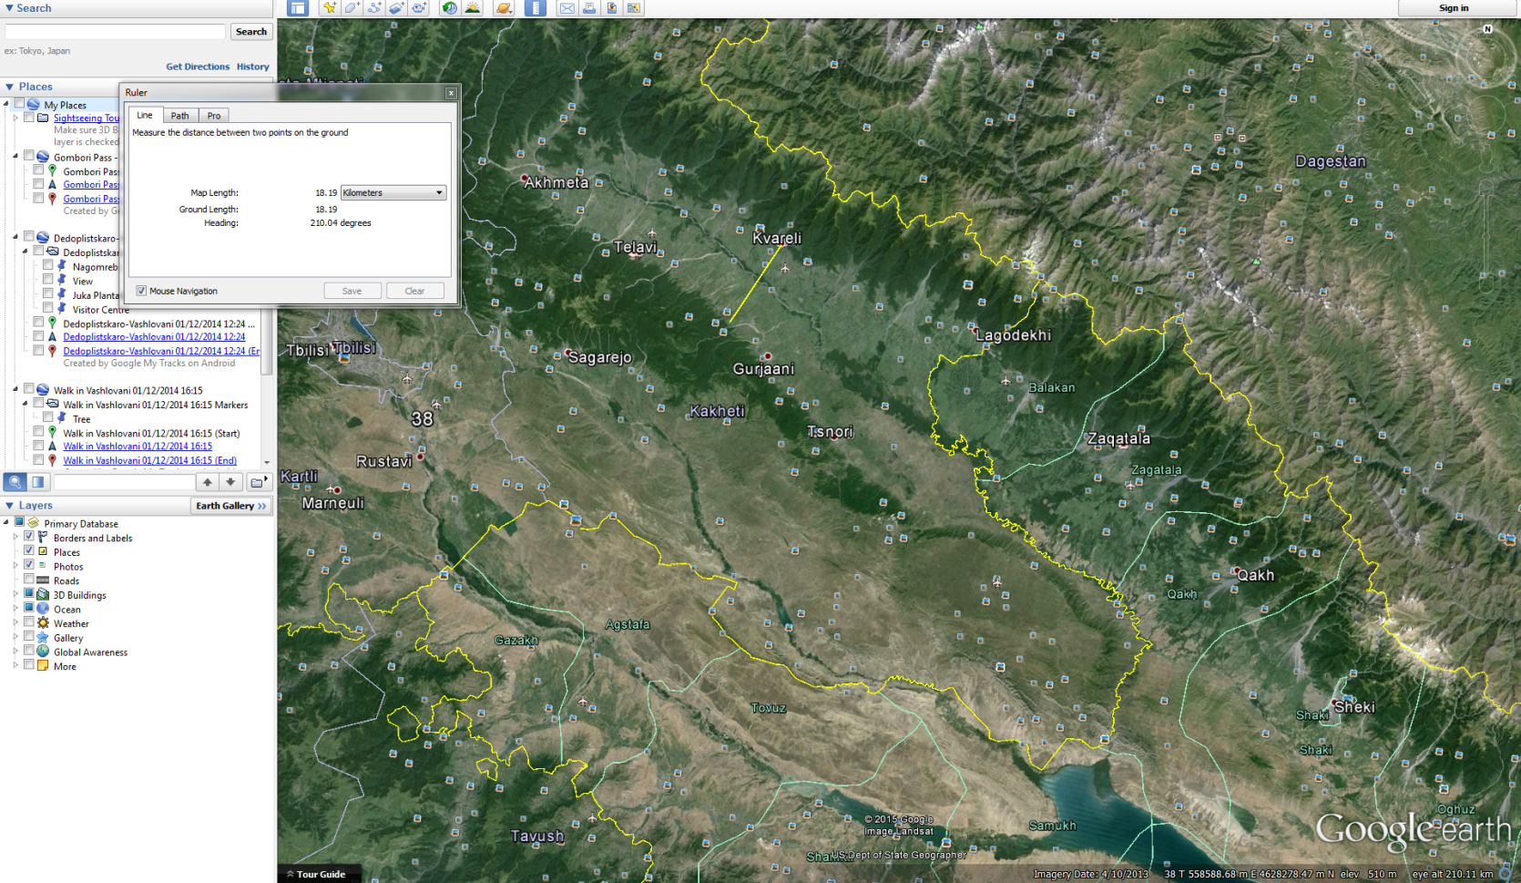
How to:
Use Google Earth Images
Using the ruler function to measure proximity
© Google earth

Slide 19
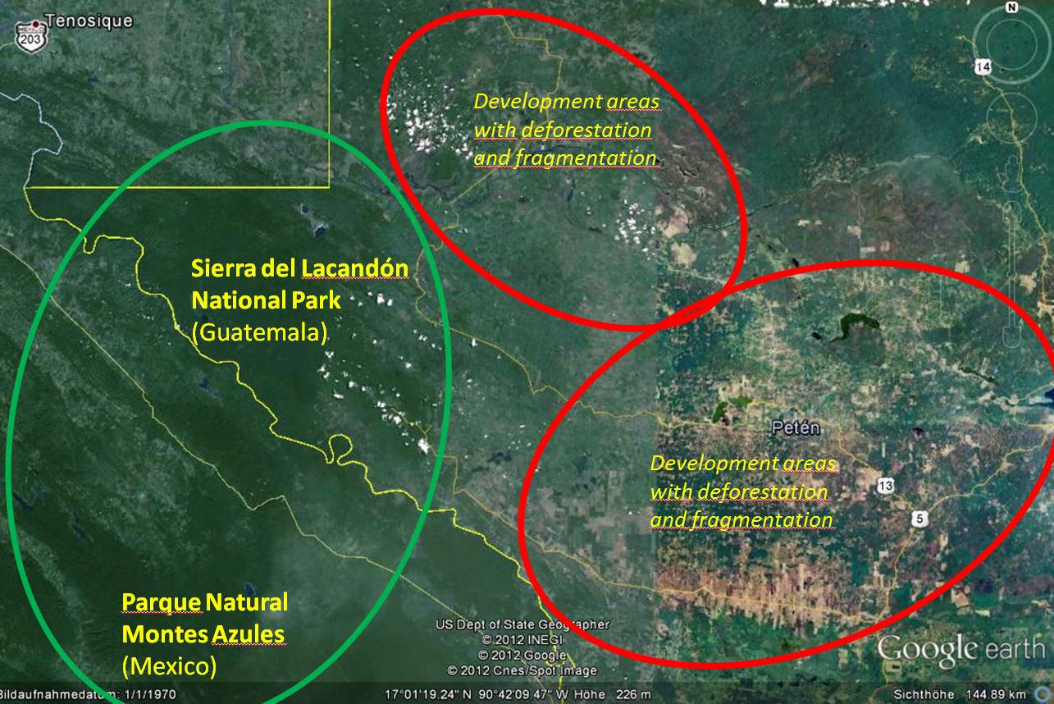
How to:
Use Google Earth Images
Analysis of all findings according to their influence on the ecosystem(s) in the area of interest
Allows fine-tuning of the geographical scope of analysis
© Google earth

Slide 20


Desktop Study
Collecting information on the designated area
  Universities & private consultancies: Scientific studies and reports
  Government: Technical reports, statistics, biological surveys, land registers
  Historical accounts, photographs, maps, paintings, registers, ledgers
  Religious centers: Often have extensive libraries
The depth of the study required depends on:
  The knowledge level of the stakeholders
  The number and distribution of critical elements identified in the first stage of the EDA
University
University
0-2015

Slide 21
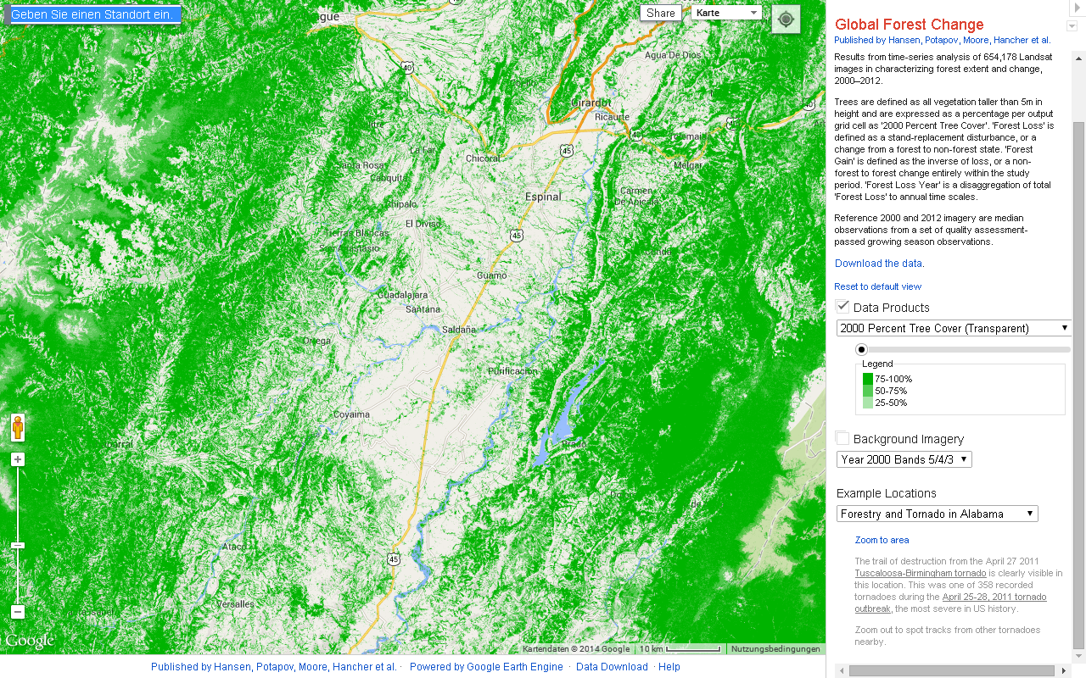
Desktop Study
Tools such as this, which allow tracking of global forest change can be used to identify other threats to the viability of the area.
Check out: Earthenginepartners
© Hansen et al. 2015
Notes:
Tool available at: http://earthenginepartners.appspot.com/science-2013-global-forest

Slide 22
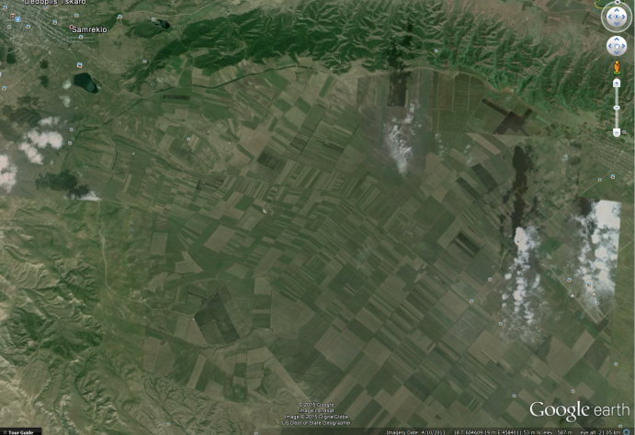
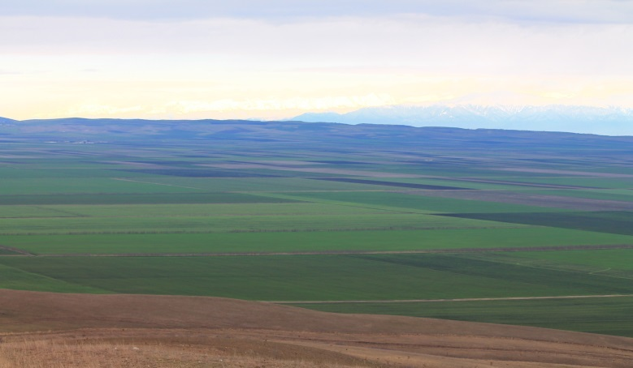
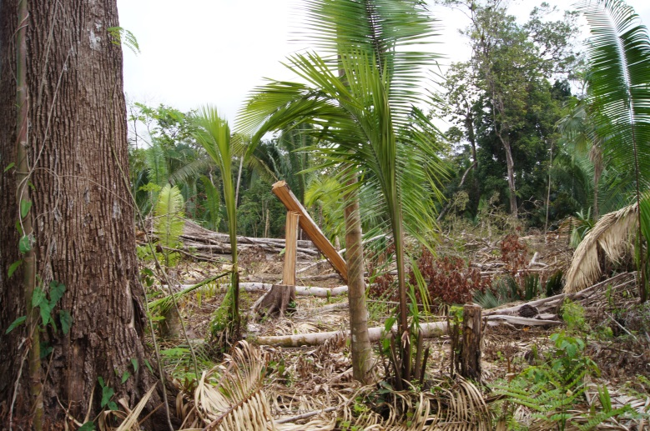
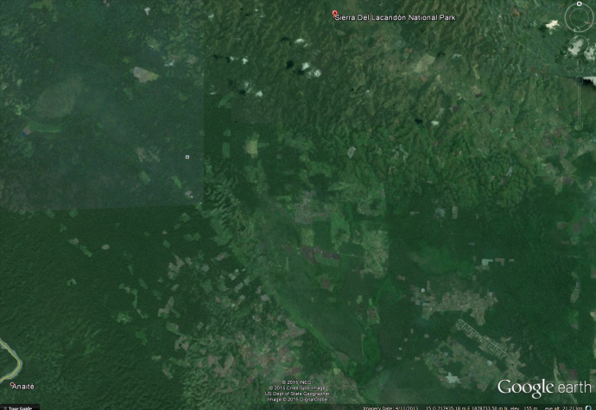
Phase II:
Field-Truthing Exercise
© Google earth
© Christina Lehmann 2014
© Google earth
© Pierre Ibisch 2011
Notes:
Pictures: Google earth & Pierre Ibisch 2014

Slide 23
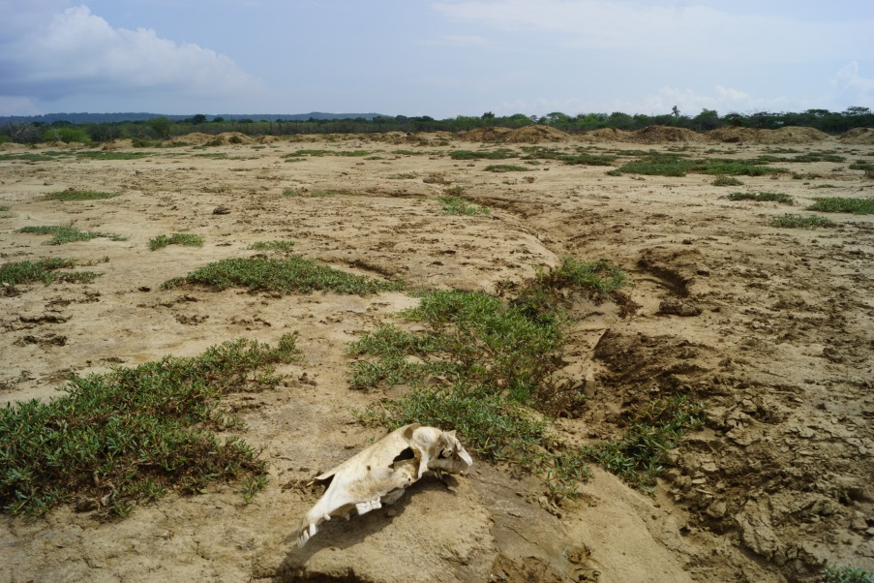
Field-Truthing Exercise
Provision of fine-grain information to avoid false assumptions and blind spots from spatial data and desktop information
Target specific areas of concern identified in the first step of the EDA
© Google earth
© Pierre Ibisch 2014
Notes:
Pictures: Google earth & Pierre Ibisch 2014

Slide 24
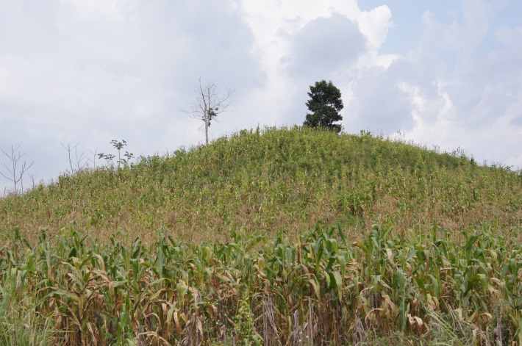
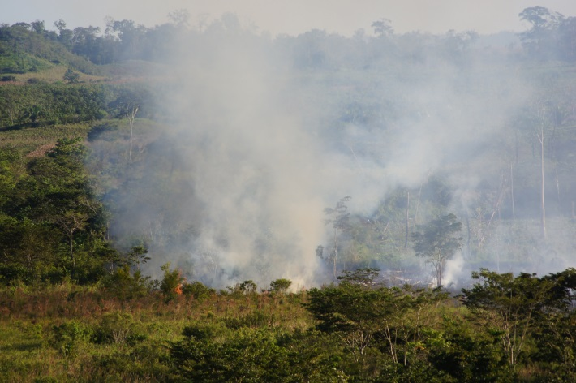
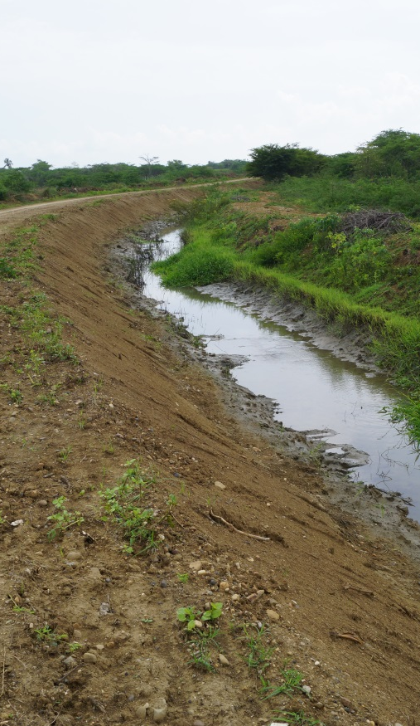
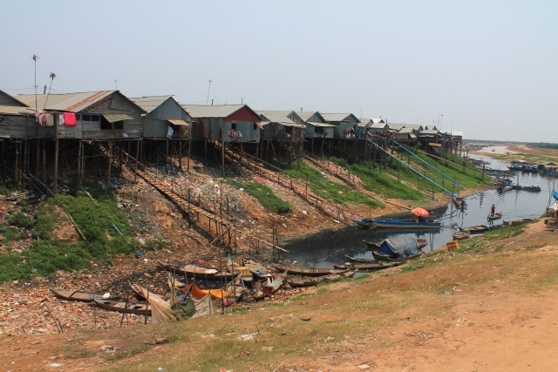
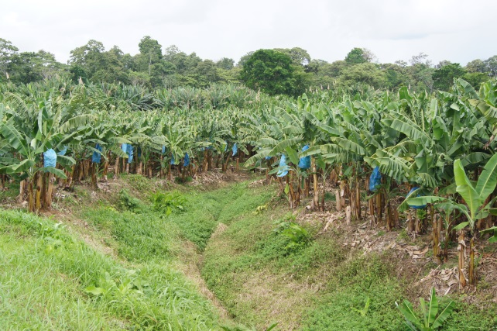
Field-Truthing Exercise
Visit known sites of disturbances (mines, factories, plantations, fisheries, sewage plants, land drains, settlements on river-fronts or estuaries)
© Pierre Ibisch 2011
© Pierre Ibisch 2012
© Christina Lehmann 2014
© Pierre Ibisch 2011
© Pierre Ibisch 2014
Notes:
Pictures to be replaced

Slide 25
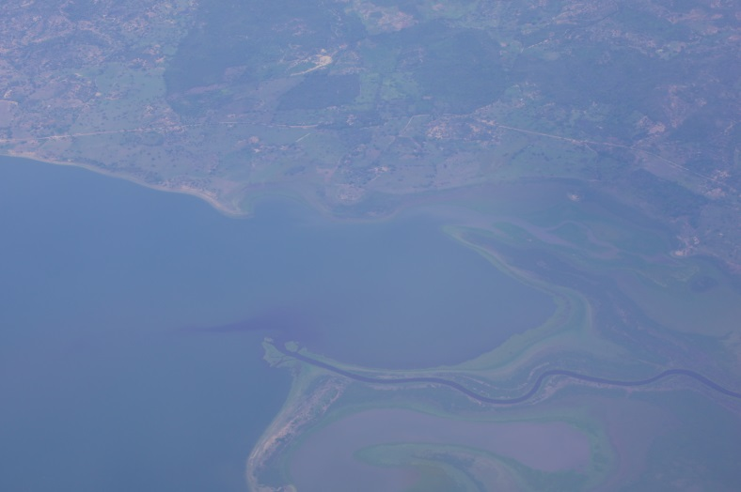
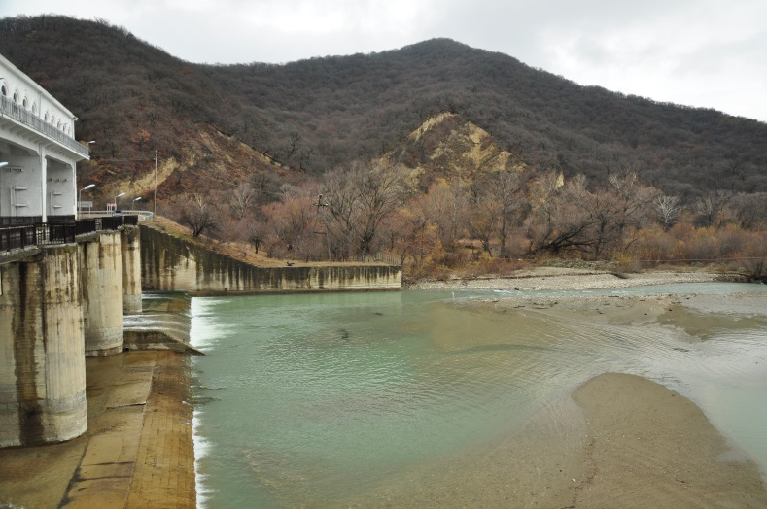
Field-Truthing Exercise
Examine river mouths for sediment discharge, discoloration and flocculation
Track rivers upstream to look for sources of discharge, barriers, incoming drains, engineering and “pinching”
© Pierre Ibisch 2014
© Christoph Nowicki 2014
Notes:
Pictures to be replaced

Slide 26
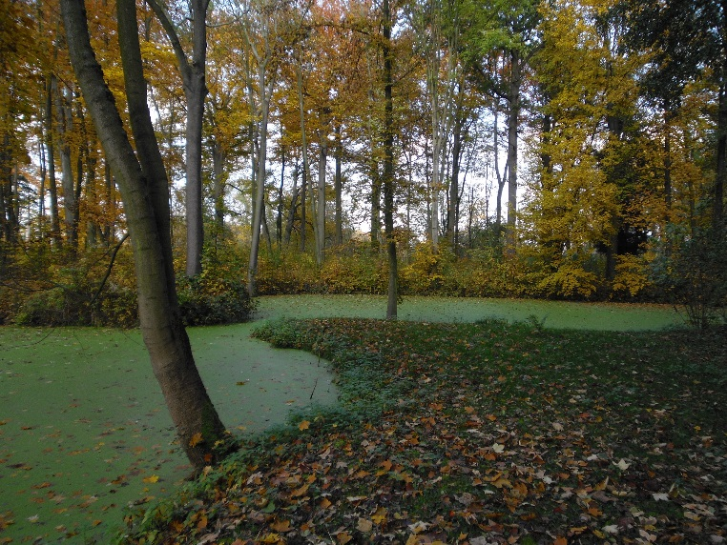
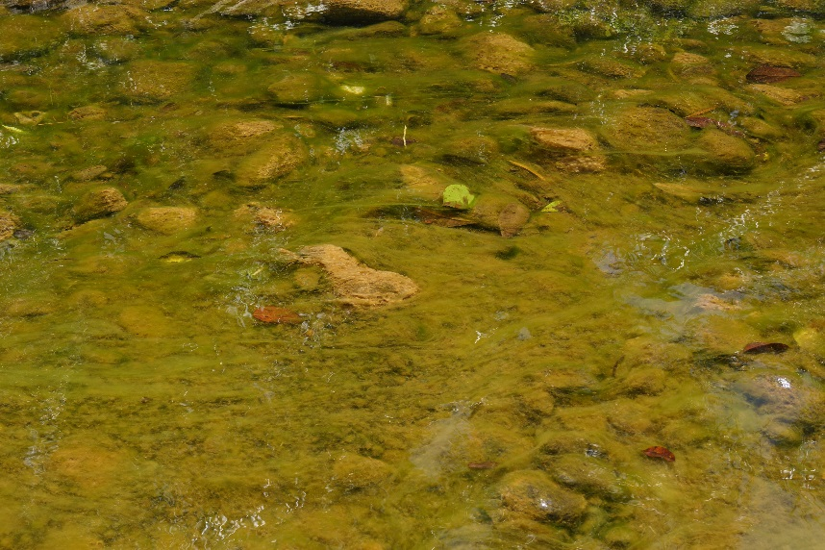
Field-Truthing Exercise
In lakes, look for algal bloom, odor, drawdown and nitrophilous plants
© Franka Seidel 2009
© Pierre Ibisch 2015
Notes:
Pictures to be replaced

Slide 27
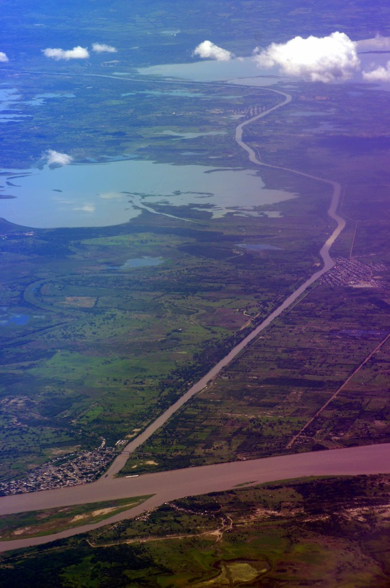
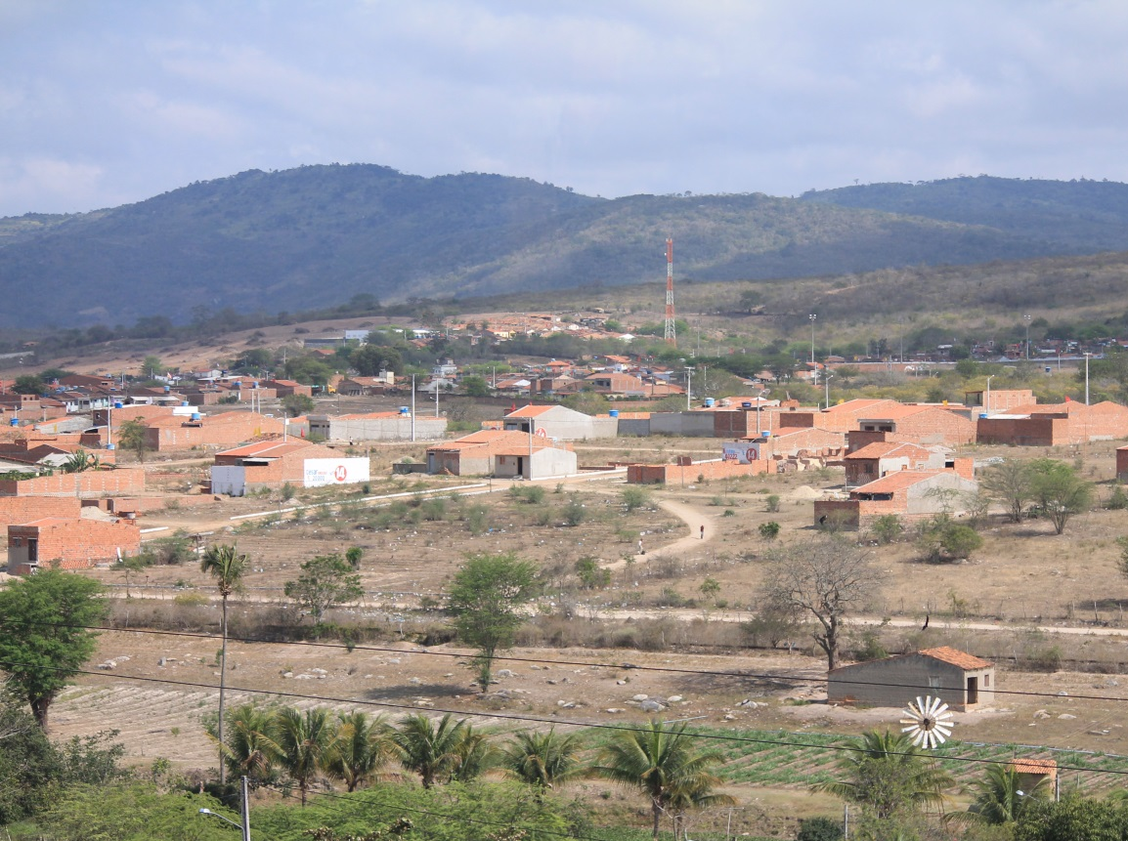
Field-Truthing Exercise
Also examine the boundaries between natural areas and urban areas
© Pierre Ibisch 2014
© Christina Lehmann 2012

Slide 28
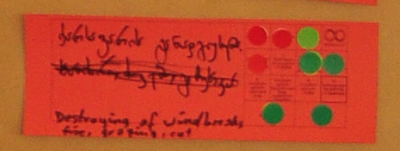
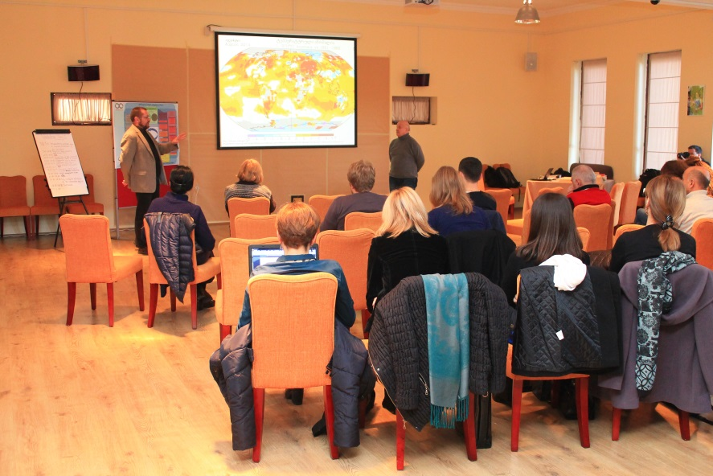
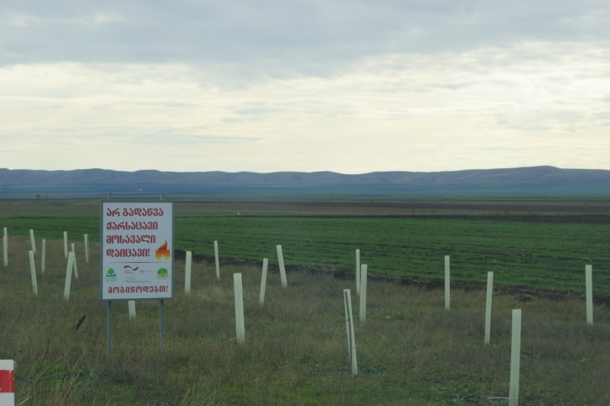
Analysis and Outcomes
Establishing a baseline of common knowledge among the workshop participants of the landscape character and the potential risks and threats to the area
Provision of a reference point for the current state of the ecosystem > cross-reference with the outcomes of the situation analysis
© Christoph Nowicki 2014
© Christina Lehmann 2014
© Pierre Ibisch 2014

Slide 29
Practical Tips
Make sure to take into account the season when taking note of changes in satellite pictures
Make sure spatial data is available - ask local partner institutions or potential sources for spatial data as early as possible
Bring binoculars and maps for the field-truthing exercise

