Slide 1
Threats: understanding the drivers of stress and the vulnerability they cause to biodiversity objects
© Pierre Ibisch 2014
Phase II
Systemic Risk and Vulnerability Analysis
Step 6

Slide 2
Credits and conditions of use
© Centre for Econics and Ecosystem Management, 2014
The Centre for Econics and Ecosystem Management strongly recommends that this presentation is given by experts familiar with the adaptive management process in general (especially as designed as the Conservation Measures Partnership’s Open Standards for the Practice of Conservation) as well as the MARISCO Method itself.
You are free to share this presentation and adapt it for your use under the following conditions:
You must attribute the work in the manner specified by the authors (but
not in any way that suggests that they endorse you or your use of the work).
You may not use this work for commercial purposes.
If you alter, transform, or build upon this work, you must remove the Centre for
Econics and Ecosystem Management logo, and you may distribute the resulting work
only under the same or similar conditions to this one.
This material was created under the leadership and responsibility of Prof. Dr. Pierre Ibisch and Dr. Peter Hobson, co-directors of the Centre for Econics and Ecosystem Management, which was jointly established by Eberswalde University for Sustainable Development and Writtle College. Compare: Ibisch, P.L. & P.R. Hobson (eds.) (2014): The MARISCO method: Adaptive MAnagement of vulnerability and RISk at COnservation sites. A guidebook for risk-robust, adaptive, and ecosystem-based conservation of biodiversity. Centre for Econics and Ecosystem Management, Eberswalde (ISBN 978-3-00-043244-6). 195 pp. - The Powerpoint Presentation was conceived by Christina Lehmann and Pierre Ibisch. Authors of graphs and photographs are indicated on the corresponding slides. Supported by the Deutsche Gesellschaft für Internationale Zusammenarbeit (GIZ) GmbH on behalf of the Bundesministerium für wirtschaftliche Zusammenarbeit und Entwicklung (BMZ).

Slide 4
Learning Objectives
Participants understand and are able to explain the rationale of the step of threat identification as important drivers to produce stresses and thus negative impacts on the conservation objects.
Participants have the skills to facilitate the identification of direct threats as well as to make clear the distinction between threats and stresses.
Furthermore they are able to guide the process to an appropriate level regarding how specific or exact should be threats or stresses.

Slide 5
Outline
What does understanding the drivers of stress (threats) mean?
Why understanding the drivers of stress and the vulnerability they cause to biodiversity?
How do we understand the drivers of stress (threats)?
Practical Tips
Notes:
?

Slide 6
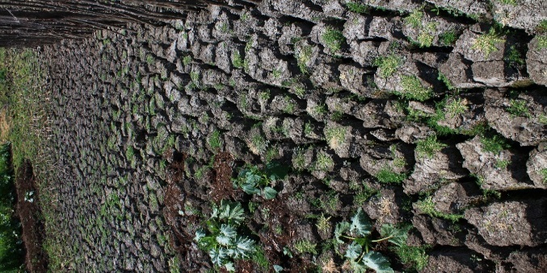
What does understanding the drivers of stress (threats) mean?
Reconstruct the reasons for stresses
Start taking a deeper look into the risks that attack the functionality of ecosystems
Preparation for identifying lever points that can be tackled first or easily
What is BEHIND the stress?

Slide 7
Why understanding the drivers of stress (threats) and the vulnerability they cause to biodiversity?
Stresses indicate a major negative impact on ecosystems
Important to understand the cause-effect-chain behind the stress in order to tackle the stresses’ drivers
Ideally threats and their drivers need to be managed and changed in order to reduce or eliminate the biodiversity objects’ stresses and thus strengthen the ecosystem

Slide 8
How do we understand the drivers of stress (threats)?
Threats can be anthropogenic-induced or natural processes that cause stresses
Today’s severe stresses in ecosystems are mostly derived from the hand of man
Direct and indirect stresses (e.g. resulting from human-induced climate change)
Indirectly caused stresses (e.g. resulting from human-induced climate change) are influencing the greatest change in natural systems (often unintentionally with wide effects; invisible at first)
Important: differentiate between stress and threat - although theory seems to be comprehensible, in practice it is more difficult
Threat
Stress
Ecosystem
Human wellbeing

Slide 9
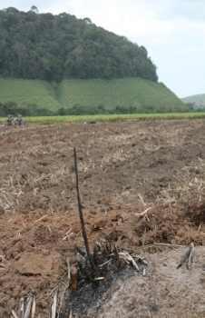
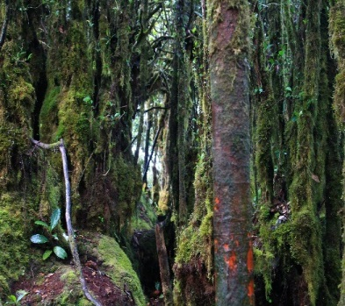
How do we understand the drivers of stress (threats)?
A threat is a human-induced forcing factor, a direct or indirect impact that will eventually induce a symptom or response (stress) in a conservation object
Stresses alter the object’s physical, chemical or behavioural state
THREAT STRESS CONSERVATION OBJECT
Human influence
© Christina Lehmann 2012
© Christina Lehmann 2012
© Christina Lehmann 2014
Human influence
Notes:
Pictures: Christina Lehmann 2012 & 2014

Slide 10
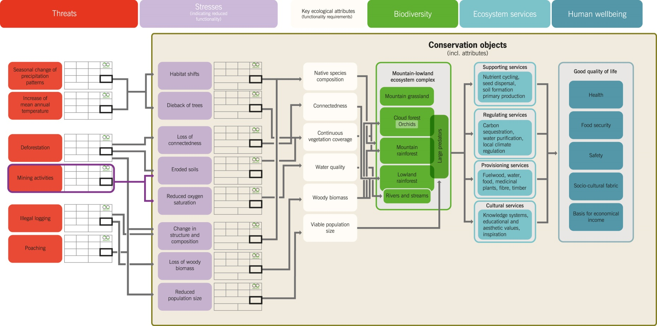
How do we understand the drivers of stress (threats)?
© CEEM 2014

Slide 11
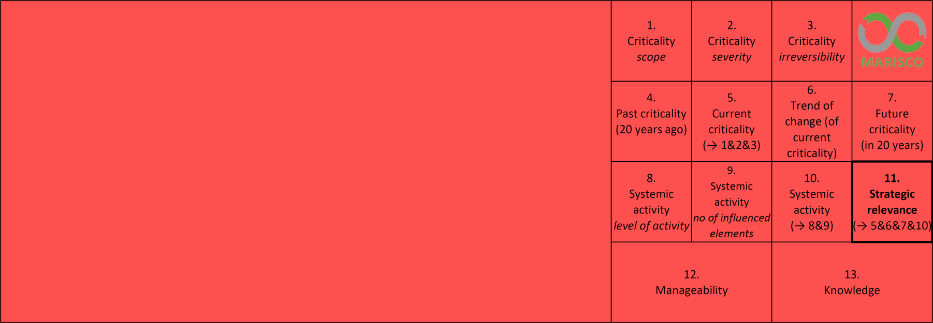
How do we understand the drivers of stress (threats)?
Red rectangular MARISCO threat cards
© CEEM 2014

Slide 12
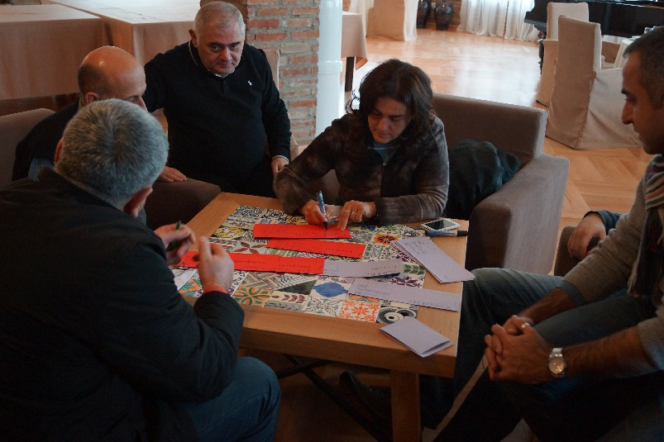
How do we understand the drivers of stress (threats)?
Consensus in the workshop team concerning links between threats and stresses is necessary before moving to the next stage
Clustering or grouping of threats is helpful and creates a better overview
Depth of threat analysis depends on available knowledge and resources spent → try to be as precise and specific as possible
Threats from IUCN-CMP’s Unified Classifications of Direct Threats may be used
© Pierre Ibisch 2014
Check out:
Unified Classifications of Threats
&
Unified Classifications of Threats and Actions
Notes:
Pictures: MARISCO Manual 2014

Slide 13
How do we understand the drivers of stress (threats)?
Classification of direct threats (taken from the IUCN-CMP Unified Classifications of Direct Threats, Salafsky et al., 2008)
Residential and commercial development: human settlements or other non-agricultural land uses with a substantial footprint.
Agriculture and aquaculture: threats from farming and ranching as a result of agricultural expansion and intensification, including silviculture, mariculture, and aquaculture
Energy production and mining: threats from the production of non-biological resources.
Transportation and service corridors: threats from long, narrow transport corridors and the vehicles that use them, including associated wildlife mortality
Biological resource use: threats from the consumptive use of “wild” biological resources, including deliberate and unintentional harvesting effects; also the persecution or control of specific species.
Human intrusion and disturbance: threats from human activities that alter, destroy and disturb habitats and species associated with non-consumptive uses of biological resources.
Natural system modifications: threats from actions that convert or degrade habitat in order to “manage” natural or semi-natural systems, often to improve human welfare.
Invasive and other problematic species and genes: threats from non-native and native plants, animals, pathogens/microbes, or genetic materials that have or are predicted to have harmful effects on biodiversity following their introduction, spread and/or increase in abundance.
Pollution: threats from the introduction of exotic and/or excess materials or energy from point and non-point sources.
Geological events: threats from geological events.
Climate change and severe weather: long-term climatic changes that may be linked to global warming and other severe climatic or weather events outside the natural range of variation that could wipe out a vulnerable species or habitat.

Slide 14
How do we understand the drivers of stress (threats)?
Guiding questions for the identification of direct threats:
Which human activities are negatively affecting the viability of the different biodiversity objects?
Which other processes are degrading the functionality of the biodiversity objects by causing stresses?

Slide 15
Practical Tips
Threats without a corresponding stress (at first sight) will occur but always be able to be worked into the conceptual model
→ “filling in the blanks”

